Slide 1
GCSE Dance
Component 1: Performance and choreography
Component2: Dance appreciation
Choreography 30%
Always work to a rehearsal plan.
The music you use is important.
Always make your choreographic intention clear.
Video your progress and reflect on your work.
Performing 30%
Practice daily – video yourself to gain feedback
Practice with focus and target
Remember your performance skills
Practice using accuracy.
Appreciation 40%
Knowledge and understanding of choreographic processes and performing skills
Critical appreciation of own work
Critical appreciation of professional work
COMMAND WORDS
Compare
Identify similarities and/or differences
Define
Specify meaning
Describe
Set out characteristics
Discuss
Present key points (detailed writing taking into account different ideas, characteristics and/or features)
Evaluate
Judge from available evidence (make an informed judgment on the effectiveness)
Explain
Set out purposes or reasons
Outline
Set out main characteristics
State
Express in clear terms
Suggest
Present a possible case (present a possible answer)
Why
Give a reason or purpose
Performance 2 x set phrases through a solo performance Duet/trio performance Choreography Solo or group choreography. | Knowledge and understanding of choreographic processes and performing skills Critical appreciation of own work. Critical appreciation of professional works.
How its assessed Performance 30% of GCSE 40 marks Choreography 30% of GCSE 40 marks Total component 60% | How its assessed 40% of GCSE Written exam: 1 hour 30 minutes 80 marks Total component 40%
Writing Frameworks
Assessment
6 Mark questions.
Name it
Example
Explain it
12 Mark questions
Describe
Interpret
Evaluate
Link
Exceptional
Highly developed
Sound
Limited
Nothing worth of credit

Slide 2
Technical Skills
Physical Skills
Expressive Skills
ACTIONS: Eg: Having good elevation makes jumps higher and creates dramatic effect. Link to space: Having the ability to transfer your weight well means you can change direction quickly. Space: The ability to use a wide variety of spatial elements in performance creates more interest and impact than performing it all in a small area. This links to your mental skills - did you plan well enough to use a studio - or was it all at home | DYNAMICS : Ability to show dynamic contrast can create surprise & variety for an audience. Being able to show a variety of dynamics may support narrative, character or intent Rhythmic Content: Links to timing - important for drawing out musical rhythm & forming close relationships with the music. Important for maintaining unison and canon well
Moving in a Stylistic Way: Your genre dictates weight and dynamic specifics. Being able to perform these well makes the style identifiable. What genre have you used & what are the weight and dynamics requirements? May link to music. Timing: Important for hitting Maintains precision accents in the music. in unison and canon sections. performing Important for contact successful. | RELATIONSHIPS: Important for hitting Maintains precision accents in the music. in unison and canon sections. performing Important for contact successfully, Being able to use relationships in performance will help to support narrative and/or intent. Being able to trust a partner enough in contact work will make it more successful.
Posture | Creates a ‘presence’ & makes performance appear confident & sincere. Important for weight bearing in contact work. Helps with focus & projection
Alignment | Clarity of shape. Helps us appear confident. Helps extension & balance. Enables safe practice in landing a jump
Balance | Maintains stillness. Accents pause in music. May show character. May show narrative/ intent. Avoids falling.
Coordination | Builds complexity by helping us layer different movements at the same time. Assists with contact work so we can catch & lift safely. Safely move in & out of floor
Control | Smooth transition into/out of floor. Helps to support dynamic changes .Supports slow dynamic .May support character/ intent. Supports balance
Flexibility | helps with extension May create dramatic impact Enables a greater range of movement Helps to show clear shape Can make movements much bigger
Mobility | Helps with quick changes of direction. Enables dynamic variety. Helps smooth transitions between movements. Makes moving in and out of the floor easier.
Strength | Health & safety in contact work. Accents dynamic force in music Confident performance. May show narrative/ intent. Supports balance
Stamina | Means we can keep going to the end. Helps build climax or character. May support intent. A strong performance. May keep unison intact
Extension | Helps project energy outwards. Makes shapes larger. Creates a much more confident performance. Helps to show clear shape
Isolation | Can support character and intent. Assists with dynamic change & impact. May work closely with music.
Projection | Connects with the audience. Builds a confident performance. Makes a performance look sincere & committed. Energises movement.
Focus | Makes a performance look confident & sincere. Health & safety in contact work. May show character or intent. Helps with turns.
Spatial Awareness | Helps group formations. Patterning & clear Helps floor pathways. Important contact for work.
Facial Expressions | Creates character. Supports narrative & intent. Can make a performance appear more confident.
Phrasing | Works closely with music. Allows us to feel the dynamic quality of the movement. Helps show where sections start & end. May support unison/ canon.
Musicality | Helps create both close & distant relationships with music. Helps to express important dynamic qualities in the music. May show character/story
Sensitivity to other dancers | Important for safety in contact work. Important for unison and canon. Can support narrative if group relationships are key.
Communication of Intent | Uses all/any of the expressive skills to show narrative & meaning within a dance. Uses all/any of the physical, technical & expressive skills to show variety in mood
Mental Skills - Process
Systematic repetition | Builds movement memory. Improves physical & technical skills. Improves expressive skills. Builds confidence.
Mental rehearsal | Builds movement memory. Prepares the mind prior to performance. We can rehearse in our heads outside of the studio to keep momentum going.
Rehearsal discipline | Regular dance attendance means we don’t miss important learning. Breaking down sections in rehearsal builds movement memory. Working on complex moments improves physical skill.
Planning of rehearsal | Being organised ensures our skills build in enough time for the final performance. Planning group rehearsals ensures we build sensitivity to other dancers properly.
Response to feedback | Helps us improve. Important that an outside person/video recording helps us spot where we can improve further - we may not be aware of it ourselves.
Capacity to improve | When we use planned rehearsal, rehearsal discipline, commitment, mental rehearsal, systematic repetition, concentration & responding to feedback - we are showing that we have the capacity to improve our skills. All of them work together.
Mental Skills – During performance
Movement Memory | Links with Systematic Repetition so we don’t forget the dance & can then use expressive skills better. Health & safety in contact work. Helps with timing
Commitment | We can make it through to the end, no matter what. Makes movement larger and more expansive. Makes performer appear confident. Energy increase
Concentration | keeps us & our partners safe in contact work. Works with Commitment to get us from the start to the end. Helps with complex sections
Confidence | we can’t just ‘be confident’ - it takes rehearsal. It builds after using mental skills in rehearsal - so that we know what we are doing. Makes a strong performance. May support character.

Slide 3
Dance Choreography
Structuring
Choreographic Process
Binary AB | A composition in 2 parts or sections
Ternary ABA | A composition in 3 parts.
Rondo ABCBDB | Music or dance form with alternating & repeating sections e.g. chorus
Episodic ABCD | A choreography with several sections, linked by a theme
Narrative | Dance that tells a story.
Beginning/middle/end | Beginning, middle and end of a dance.
Unity | A sense of ‘wholeness’ or harmony
Logical sequence | The flow of phrases or sections of a dance.
Transitions | Links between dance phrases or sections.
Researching | Investigate background information and meaning around a chosen stimulus.
Improvising | To create and explore movement without any forethought or preparation.
Generating | Create movement or phrases from initial ideas.
Selecting | Carefully choose as being the best or most suitable movement ideas.
Developing | Elaborate or expand by manipulating and developing the movement material.
Structuring | Organise the movement material into a whole, by creating sections and a climax.
Refining and Synthesising | Perfect and polish.
Choreographic Devices
Motif Development
Ways in which a movement phrase can be varied
Retrograde
Change levels
Fragmentation
Change directions
Add actions
Repetition
Take away actions
Change dynamics
Relationship Content
Motif | A movement phrase encapsulating an idea that is repeated and developed throughout the dance.
Motif Development | Ways in which a movement phrase can be varied.
Repetition | Performing the same action or phrase again.
Contrast | Movements or shapes that have nothing in common.
Highlights | Important moments of a dance.
Climax | The most significant moment of the dance.
Manipulation by number | How the number of dancers in a group is used.
Unison | Two or more dancers performing the same movement at the same time.
Canon | When the same movements overlap in time.
Lead and follow | One dancer moves, the other follows.
Mirroring | Performing the same action but opposite.
Action and reaction | When one dancer performs a movement which cause another to react.
Accumulation | Dancers performing a series of movements and join in at different times.
Complement and contrast | Where dancers movements are different but similar/ when dancers movements are different style.
Counterpoint | Where dancers perform different motifs at the same time.
Contact | Physical support or touch between dancers
Formations | Shapes or patterns created in space by dancers

Slide 4
Section A – Hypothetical Choreography
Section B – Own Work
Stimulus – an inspiration for an idea or movement
Make sure you know your…
Set phrases
Duet/trio performance
Solo/group choreography
How do you outline your dance idea?
My dance would be about conflict and confusion, because the red stop light and the green go light are on at the same time. One dancer would show anger and the other would show joy and they would swap roles constantly.
Performance Skills
Technical Skills
Physical Skills
Expressive Skills
Mental Skills
Choreographic devices
Structuring devices
What is a motif?...
Start at the back of the stage and slowly turn your head. Quickly turn to face the front and drop to a crouch. Shoot one arm upwards and sharply clench the fist.
This is now a doable motif. It’s long enough, it’s described step by step and it includes actions, space and dynamics. It might not be very interesting but that doesn’t matter.
Production Features
Performance environments | Proscenium arch End stage Sit sensitive In-the-round
Aural Setting | Song Instrumental Orchestral Spoken word Silence Natural sound Found sound Body percussion
Name it
Example
Explain it
Motif Development
Keep it simple – change direction, level or dynamics
I would change the direction. Instead of shooting my arm upwards, I would shoot it out towards stage right.

Slide 5
Dance Anthology
 | Artificial Things | Infra | Shadows | A Linha Curva | Within Her Eyes | Emancipation of Expressionism
Stimulus | An isolated figure perched on a collapsed wheelchair, in a snow covered landscape - viewed from afar as if through a snowglobe. Paintings by Goran Djurovic. The dancers’ personal experiences. | INFRA : ‘below’ in Latin Life beneath the surface of a city The Waste Land poem: by TS Eliot The London Bombings [mentioned in the interview with Wayne McGregor] | The music: Fratres for Violin & Piano by Arvo Part The relationships between family members as they deal with the fear of an outside force. | Brazilian Culture Celebration of Brazilian Life The title: ‘The Curved Line’ | A Love Story with a Twist The dancers can never be together. Love and loss Longing and memory Dependency and loyalty | Til Enda [the music for Section 4] Freedom of expression through hip hop movement
Choreographic Intent | Life’s limitations and resolution. The gaze of the other. Constricted within the snowglobe. | Seeing below the surface of things Human relationship | A small familypossibly Eastern European, facing deprivation and the fear of what lies outside their home. | Having fun Men competing for and showing off to the women Sense of samba parades | An abstract tragic love story. The pull back towards the girl’s late lover contrasted with the desire to move on | An emotional journey Order and chaos
Assessment – 12 marker 1 x Anthology 2 x production Features
Assessment – 12 marker Similarities and Differences

Slide 6
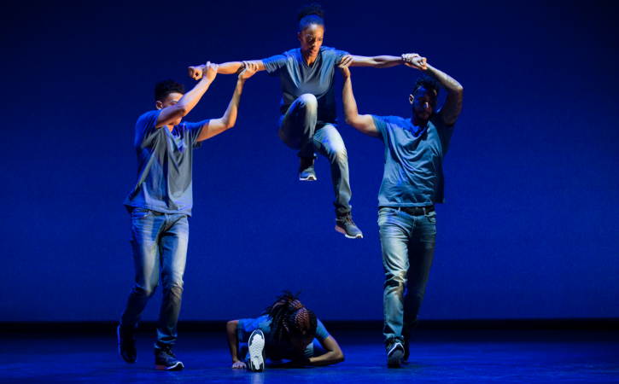
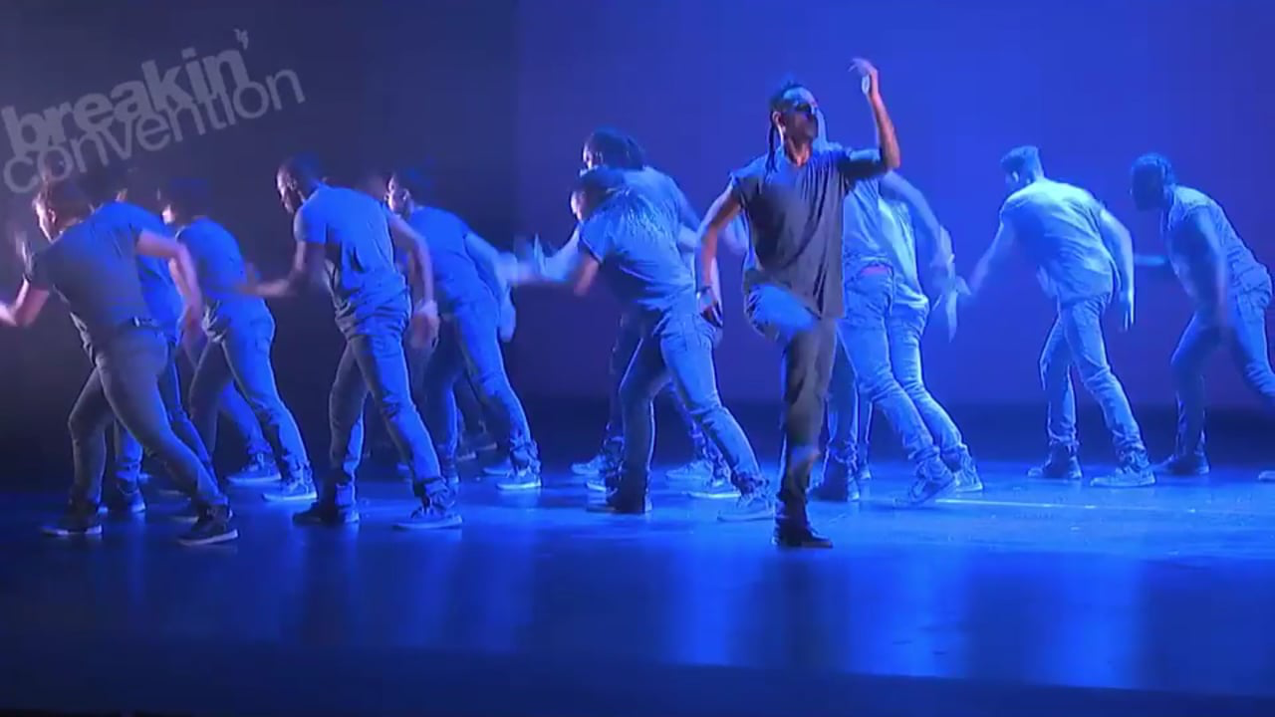
CHOREOGRAPHER: Kendrick H20 Sandy
COMPANY: Boy Blue Entertainment
AURAL SETTING
Kendrick writes out counts & uses symbols in his notes to ensure movements complement the particular instrumentation & accents.
Style:
Hip Hop including: krumping, waacking, popping, locking, breaking.
CHOREOGRAPHIC INTENTION
Journey through life (each section a scene, a moment in life)
Order and Chaos (highlighting restrictions of an individual style of hip hop dance).
STIMULUS
The music Til Enda was a starting point for the piece. Section 4 created first. The title was another starting point.
4 SECTIONS (STRUCTURE)
Genesis (start of life)
Growth and struggle
The connection and flow between people
Empowerment
LIGHTING
Intense blue colour – represent energy
Central focus at beginning and gradually light whole stage by end.
Spotlights used.
Lighting helps identify different sections.
CHOREOGRAPHIC APPROACH
Exploring & abstracting hip hop movement & ‘signature’ company movements in a contemporary way. Signature motifs (Ninja Walk, Ninja Glide, Ninja Static & Chariots of Fire)
DURATION: 11 minutes
COSTUME
Represents company (casual, blue, ‘clean’ look).
Hair tied back to see facial expressions.
Fitted to show isolations
Not restrictive to movement
Jewellery worn by some to help express individuality.
Cant be seen when not in spotlight
White light in section 2 off-stage right – significant moment

Slide 7
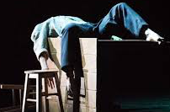
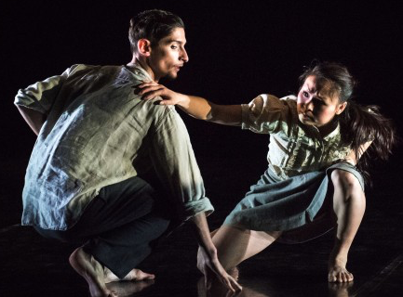
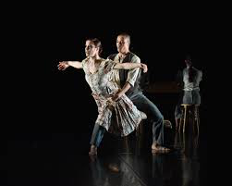
CHOREOGRAPHER: Christopher Bruce
COMPANY: Phoenix Dance Theatre
AURAL SETTING
Arvo Part’s Fratres – the version for violin & piano pre-recorded for performance. Music has no break in tempo. Music in minor key to help with dark feel of piece.
STYLE:
Neo-classical
CHOREOGRAPHIC INTENTION
Family in a dining room/kitchen
Poverty
Holocaust/political events
Fear of outside
STIMULUS
The music was the initial starting point. The music ‘evokes images of a European history and tradition steeped in over a 1000 years of suffering & human experience’.
STRUCTURE: Semi-narrative Solo, duet, trio, quartet
LIGHTING
Lighting design to create intimate space on stage depicting feeling of a ‘room’. Shadows created on stage.
Could be dim to represent candle light, showing poverty, or hiding from outside.
CHOREOGRAPHIC APPROACH
Bruce waits to work with dancers so he can be influenced by them. Started dance with idea of family unit sitting at dinner table. The ‘anxiety of the music’ greatly influenced the movement content, with the form of the piece allowing each member of family to tell their story.
STAGING/SET
Props: Table, 2 stools, bench, coat stand, 3 suitcases, 1 sack.
All worn – poverty
Helps show dining room
Integral in climax – used to barricade door
DURATION: 12 mins
COSTUME
Costumes clearly gendered, depicting era of the 1930s-1940s. Simple shirts, skirts, trousers, dresses and large overcoats.
Colours muted and worn down – deprivation & poverty. At end, they put shoes and coats on. Coats oversized for children - show poverty.

Slide 8
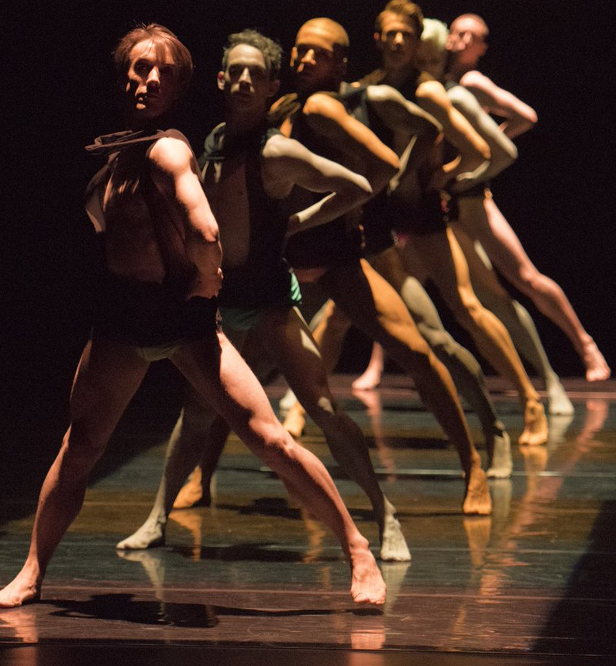
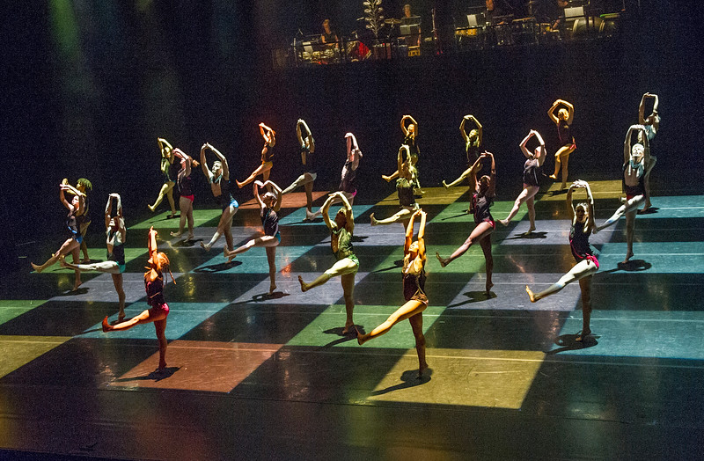
CHOREOGRAPHER: Itzik Galili
COMPANY: Rambert
AURAL SETTING
Music by Percossa – 4 man percussion group. Also includes vocals. Inspired by Brazilian samba music.
DANCERS:
28 (15 male/13 female)
CHOREOGRAPHIC INTENTION
Simply have fun
Create a vibrant Brazilian inspired samba parade
Communication between Brazilian men & woman
STYLE: Samba, capoeira and contemporary.
STIMULUS
The title A Linha Curva means The Curved Line in Portuguese. Stimulus is Brazilian culture.
STRUCTURE
Big ensemble dance sections interspersed with scenes that have more narrative and character.
DURATION: 23 mins
STAGING/SET
No set apart from raised platform at the back for band. Skateboards are used in 1 section for 5 male dancers to create contrast.
LIGHTING
The different coloured and timed lighting creates a chequer-board effect on stage & defines the lines & spacing for dancers. Timing of lighting is pre-programmed and dictates speed and pace of the dancing & music.
CHOREOGRAPHIC APPROACH
Itzik worked collaboratively with the dancers and nearly all motifs were composed from improvisation. Asked dancers to create a short solo. They all learnt each others.
COSTUME
Male and female both wear black vests with different coloured Lycra shorts. Colours carnival inspired and enhance lighting. Shorts are made from wet look lycra and come in 10 different colours. Men wear metallic disc-shaped collars that reflect the light for opening. Costume can’t be seen when not in light.

Slide 9
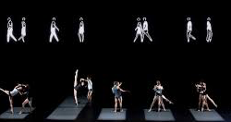
CHOREOGRAPHER: Wayne McGregor
COMPANY: The Royal Ballet
AURAL SETTING
Music by Max Richter. The score mixes melancholy string melodies with electronic sounds and everyday sounds such as train-whistles.
DANCERS:
12 (6 male/6 female)
CHOREOGRAPHIC INTENTION
Seeing below the surface of things
Inferences – particular types of relationships
Let audience make their own interpretation
DURATION: 28 mins
STIMULUS
The title Infra – comes from Latin word ‘below’. The Wasteland poem was also a stimulus used. And finally London Bombings.
STYLE: Contemporary ballet.
COSTUME
Fitted shorts, vests, t-shits in flesh, black ,white, grey colours. Females wear pointe shoes. Street clothes worn for brief crowd. Colours could represent dust from London Bombings (no colour)
LIGHTING
Lighting design by Lucy Carter. Lighting relates closely to structure. Occasionally dancers are lit by shafts of light and at 1 point 6 rectangles of light frame 6 duets. Colours are used to highlight different sections.
STAGING/SET
An 18m LED screen is placed high on the black back wall. It runs the width of the stage – there is mesmerizing flow of electronic walking figures.
PERFORMANCE ENVIRONMENT:
Proscenium arch
CHOREOGRAPHIC APPROACH
SHOW – a phrase to whole/part cast
MAKE – dancers make up a phrase and others watch and develop
TASK – set choreographic tasks for dancers
Finally, pieces all his parts together like a jigsaw to music.

Slide 10
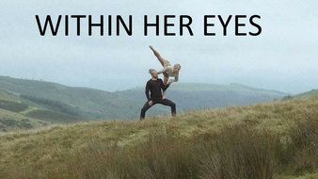
CHOREOGRAPHER: James Cousins
COMPANY: James Cousins company
AURAL SETTING
Composition created specifically for the work. Music combines electronic elements with strings & piano creating a haunting & emotive accompaniment.
DANCERS:
2 (1male/1female)
CHOREOGRAPHIC INTENTION
To create a dance film that maintained the emotional intensity & visceral energy of the live stage performance of ‘There We Have Been’ & to portray an abstract tragic love story that is open for interpretation.
DURATION: 17 mins
STIMULUS
A love story with a twist. Inspired from both personal experiences and well known narratives. Communicating themes of love and loss.
STAGING/SET
Set in remote locations to give the feeling of isolation and highlight the characters separation from society. Setting progress from open landscapes to intimate settings.
COSTUME
Styilised everyday clothes. Female dancer wears a beige shirt & skirt. Male wears jumper & jeans. Males dark in contrast to hers light.
Male dark: links to earth
Females light: links to more ethereal & celestial feel.
LIGHTING
The film only uses natural light of the environment. There is a development from daytime to evening into night to show a passive of time.
PERFORMANCE ENVIRONMENT: Site-sensitive; dance for camera.
STYLE: Contemporary/contact work
CHOREOGRAPHIC APPROACH
The film uses choreography from Cousin’s stage production. Two starting points: narrative and emotional themes and the physical idea of keeping female dancer off the floor. Created through dancers using improvisation.

Slide 11
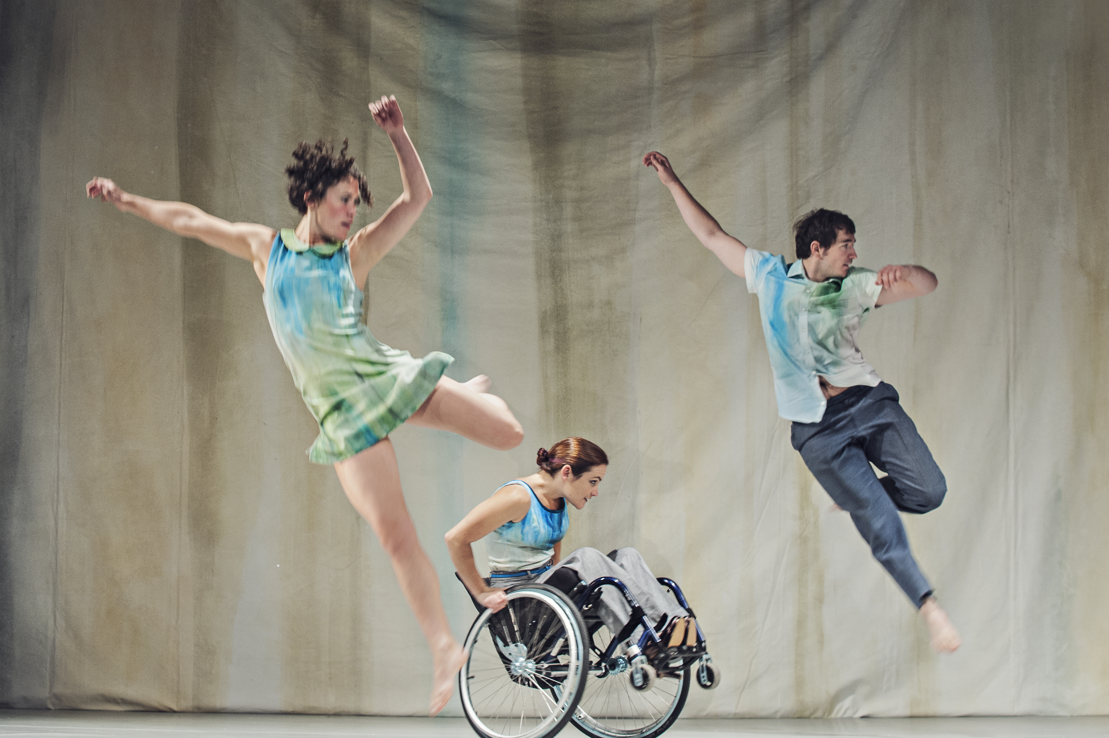
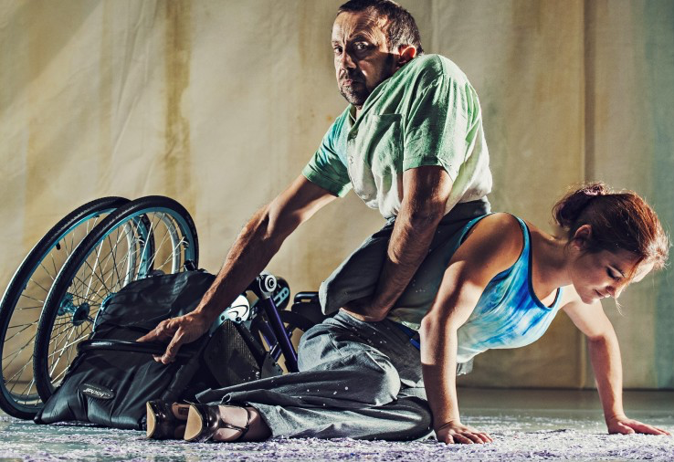
CHOREOGRAPHER: Lucy Bennett
COMPANY: Stopgap Dance Company
AURAL SETTING
Futuristic atmosphere acknowledging time has passed & that old ways had broken down. He used whole of piano to create cold, ambient sound. Also uses sound of paper snow & added other sound effects like rumble, wind & footsteps through snow. Song also used.
DANCERS:
2 (2 male/2 female)
CHOREOGRAPHIC INTENTION
Characters coming to terms with life’s limitations.
We all live within certain confinements and we are all subject to the gaze of others.
Surrendering to the fact we all have to live with individual regrets.
DURATION: 20 mins
STIMULUS
A snow covered urban landscape with an isolated figure perched on a collapsed wheelchair. This figure is being observed from afar as if through a snow globe.
COSTUME
Wash blue and green, merging with the backdrop. Looks as if paint is running from the garments, which references bring stuck in a painting.
LIGHTING
The lighting focuses in on 1 or 2 spots. It opens out in the middle, with a blue wash & warm & cool side lighting before closing down to another spot for the final solo.
STAGING/SET
Crudely painted heavy backdrop in which paint looks as if it is running down the canvas. Paper snow is scattered on ground. 2 stools. Headless suit on mannequin legs perched on a 3rd stool.
PERFORMANCE ENVIRONMENT:
Proscenium arch
STYLE: Inclusive contemporary dance
CHOREOGRAPHIC APPROACH
Bennett uses a collaborative approach within her choreography. Stopgap’s dancers are encouraged to actively contribute to the process through choreographic tasks that Bennett initiates. Much of the material is driven by Laura Jones’ movement in her wheelchair & has been translated by the standing dancers.

