Slide 1
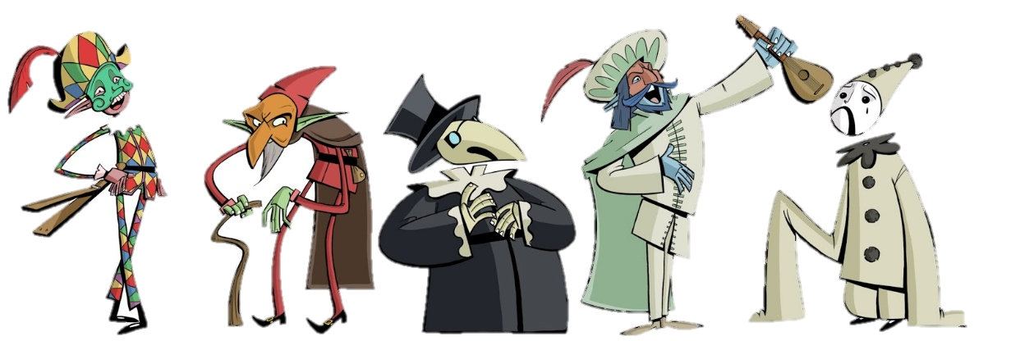
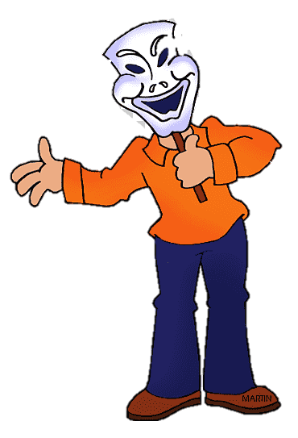
Theatrical skills
These skills can be used in a performance to create a story:
Freeze frame: A frozen moment in time expressing a character / scenario.
Still image: frozen image that symbolises an idea or relationship
Thought tracking: a character saying their thoughts aloud
Hot seating: a character is asked questions and the actor responds in role
Narration: telling the audience what is happening
Mime: suggesting action, character, or emotion without words
Improvisation: creating a scene without a script
Proxemics: the use of space on stage to create meaning
Levels: the use of height to show status
Status: the power one character has over another
Physical Theatre: creating objects, set or meaning through the use of the body
Introduction to Basic Drama Skills
Introduction to Basic Drama Skills
Vocal skills​
Pace: how fast or how slow the character speaks​
Power: how loud or how quiet a character speaks​
Pitch: how high our how low a character speaks​
Pause: moments where the character stops talking​
Tone: shows what the character thinking or how they are feeling
Autumn Term 1:
To successfully represent a character you show be using both physical and vocal skills
Physical skills
Facial expression: showing emotion of the character through the face
Body Language: using your body to show the characters emotion
Physicality: using your body to show the character
Gesture: a movement of part of the body to show meaning.
Mannerisms: habitual gesture or way of speaking or behaving in role
Gait: the way a character walks
Year 7 Drama

Slide 2
Autumn Term 2:
Year 7 Drama
Appreciating Theatre:
How to Evaluate in Drama
How to Analyse in Drama
Evaluating OUR OWN PERFORMANCE AND THE PERFORMANCES OF OTHERS
Introduction: Your performance: describe in detail the performance and the character you played Someone else's: as an audience member what did the performance make you think about? Select one character and write in detail about them | Your performance: What theatrical skills did you used, why did you use these? What was the effect you were hoping to have on the audience? Someone else’s: What did you learn about the characters and the story from their performance. What do you think the aim was? Was it funny? Sad? Compelling? Unpick the theatrical skills one performer used and think why? What was the purpose? What affect did it have on you?
2. Your performance: Do you think you were able to create a successful performance, meeting your aims and intention? Someone else’s: Do you think they were able to create a successful performance? | Your performance and someone else’s: If you / they were successful why? If you weren’t why not? What could you / they have done differently? What was good about your / there personal performance and how could you / they improve? LINK TO THREATRICAL SKILLS USED THROUGHOUT!
3. Write about the performance as a whole. | What worked well? What didn’t? Do you have any ideas about how you / they might have altered/changed the performance if given more time?
Analyse OUR OWN PERFORMANCES AND SOMEONE ELSE’S:
Space: | Is there a fourth wall? How have you / THEY used proxemics to show relationships? What relationship was created? What is the focus of the audience?
Character: | How have you / THEY shown the age of the character? How have you / THEY shown the personality of the audience? How has the character helped to create meaning in your / THEIR performance? LINK TO THEATRICAL SKILLS THROUGHOUT
Analysis of the moment:
Explain in detail the meaning created by the moment, relating to the audience. E.g. how it made the audience understand the character, themes or story, how it created empathy, comedy, tension or communicated a message for the audience etc.
Your personal– how did you: think/feel/react/respond/engage? What meaning was communicated to you at this point.

Slide 3
Key Terms:
Exaggeration: To magnify (make bigger, more over the top, a performance skill)
Clocking the audience: a moment when a character breaks the fourth wall and looks at the audience.
Point of focus: creating a moment where the audiences focus is on a characters or a point on stage
Mime: suggesting action, character, or emotion without words
Masks in Theatre AO2
The rules of mask:
1. Never put the mask on / take it off in front of the audience
2. Never touch, reposition your mask
3. Don’t talk whilst wearing the mask
4. Ensure that you face the front, as much as possible, whilst performing.
Masks in Theatre:
Steps to Building a Character:
1. Copy exaggerated facial expression of the mask
2. Develop exaggerated body language to suit the character
3. Develop an exaggerated walk to suit the character
Stock Characters
Protagonist. Handsome, strong, brave, honest and reliable. Status: Middle class or higher
Damsel in Distress. Beautiful, courageous, innocent and vulnerable. Status: Middle class or higher
Antagonist. Cunning, without morals, dishonest, cruel and evil. Status: Middle class or higher
Comedy duo this is usually two people who make the audience laugh, they are often joined at the hip
Year 7 Drama:
Spring Term 1:

Slide 4
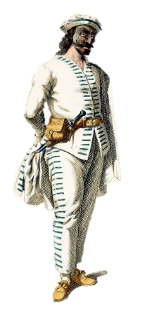
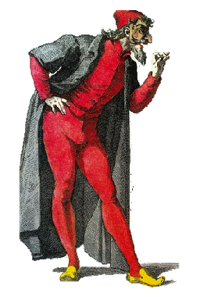
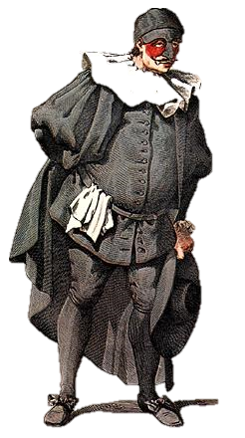
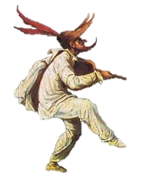
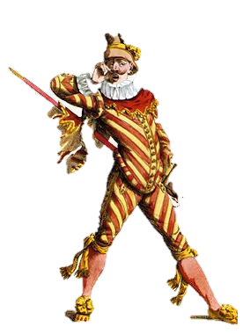
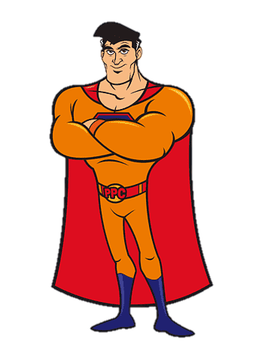
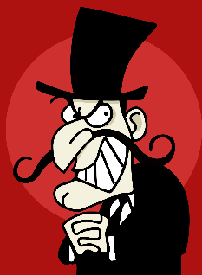
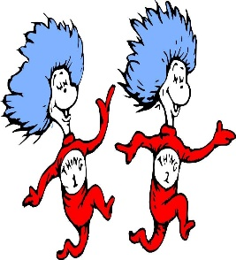
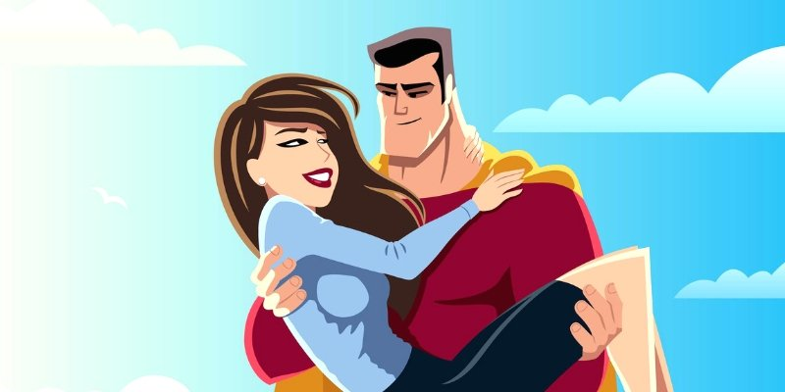
Commedia Del Arte AO1
Lazzi: a basic outline for a scene, which is then improvised by the actors
Status: power difference in the relationship between two characters
History of commedia:
Improvised play
Originated in Italy 16th Century.
Commedia characters:
Zanni: Physicality:
Leads with his nose, his legs and arms are forward
He gazes up and looks at everything in wonder
He arches his back when he walks
Pantalone: Physicality:
Leads with his head.
Walks with a crooked back, with one hand in front of him (ready to steal something!) and the other behind his back
Shuffles with legs bent.
He pretends he is fragile with old age and then moves very fast when stealing.
Moves his hand a lot
Il Dottore (The Doctor): Physicality:
He is extremely fat, and moves very slowly. He often holds his belly and runs out of breath very easily!
The Doctor is usually drunk.
His belly sticks out and he leans back on his feet.
Il Capitano: Physicality:
Talks in loud voice to be the center of attention.
When he gets scared he screams really loud!
He walks with his head held high, nose in the air and should back… because he thinks he’s very important.
Leads from the chest.
Magnifico: Physicality:
Leads with his head, like an eagle.
He looks down on everything
He walks and stands with his hands behind his back
Swishes his cloak around him when he turns and stop
Commedia Dell’Arte
History of Commedia Del Arte
Commedia Del‘Arte is a type of improvised play.
They knew the scenario and then improvised.
It originated in Italy in the 16th Century.
Commedia Del’Arte (roughly translated) means ‘Comedy of the profession’.
Style
The form of Theatre came after the ‘Black Death/Plague’ so most of the storylines are based around themes from that time:
Greed, Hunger, Death and Love.
Year 7 Drama:
Spring Term 2:
The characters in Commedia never learn from their mistakes
Physicality
The actors wore masks
They had to show emotions through their body.
They would have big gestures.
The longer the nose on the mask, the more stupid the
character

Slide 5
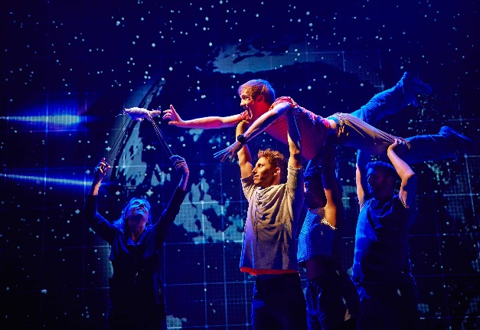
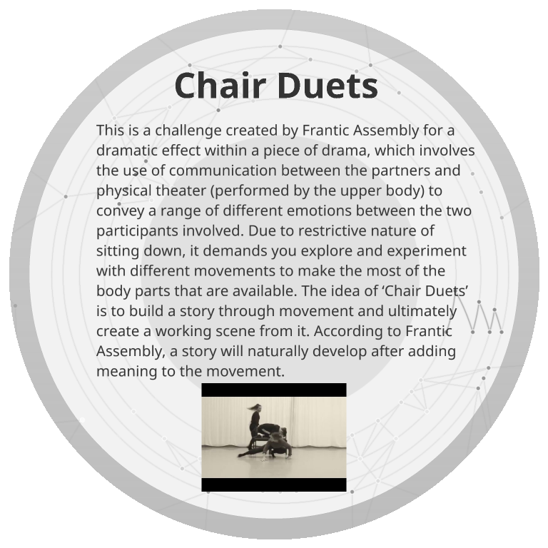
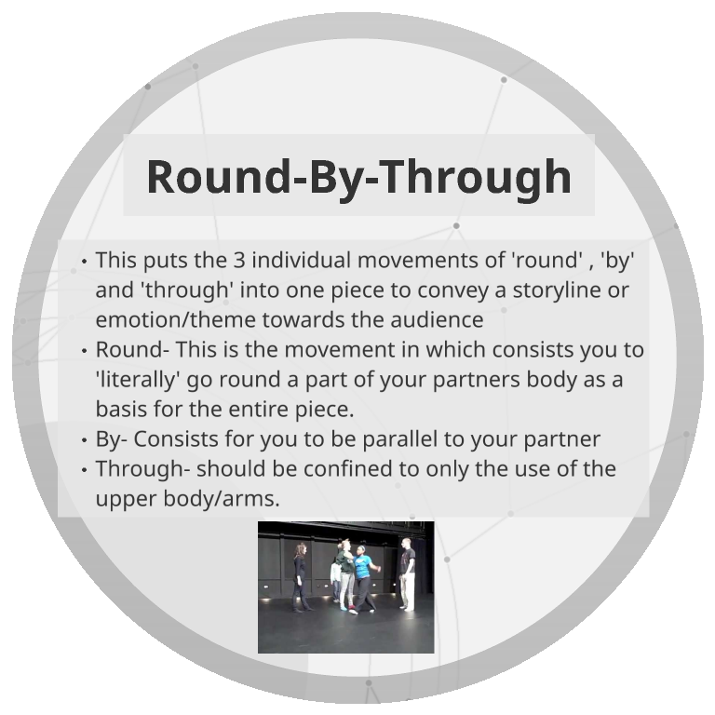
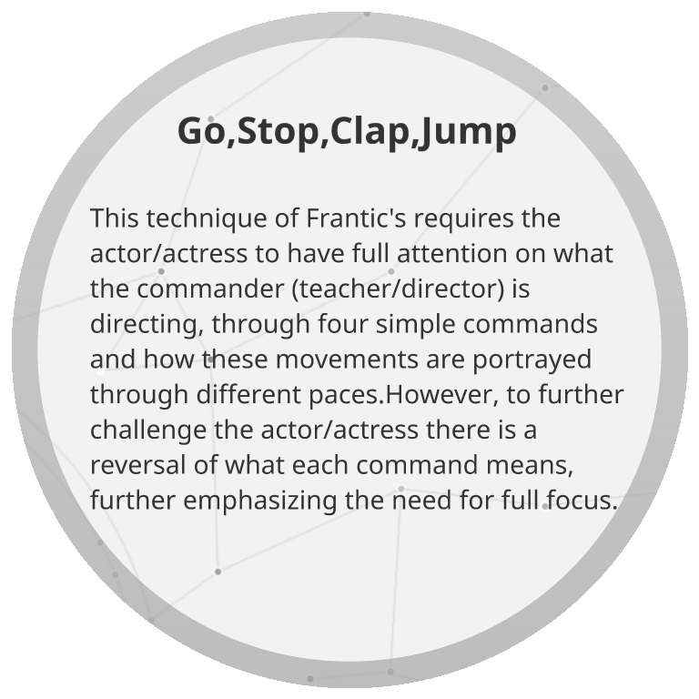
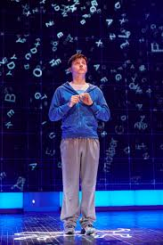
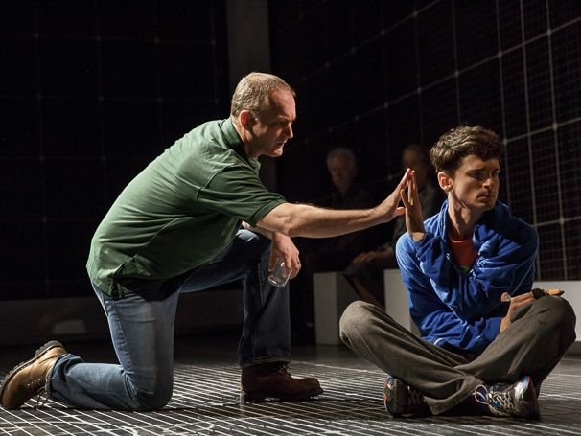
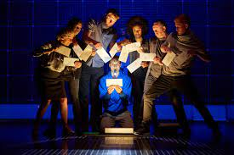
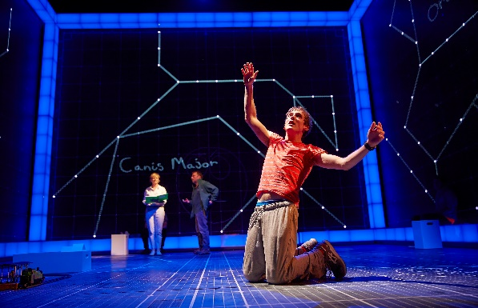
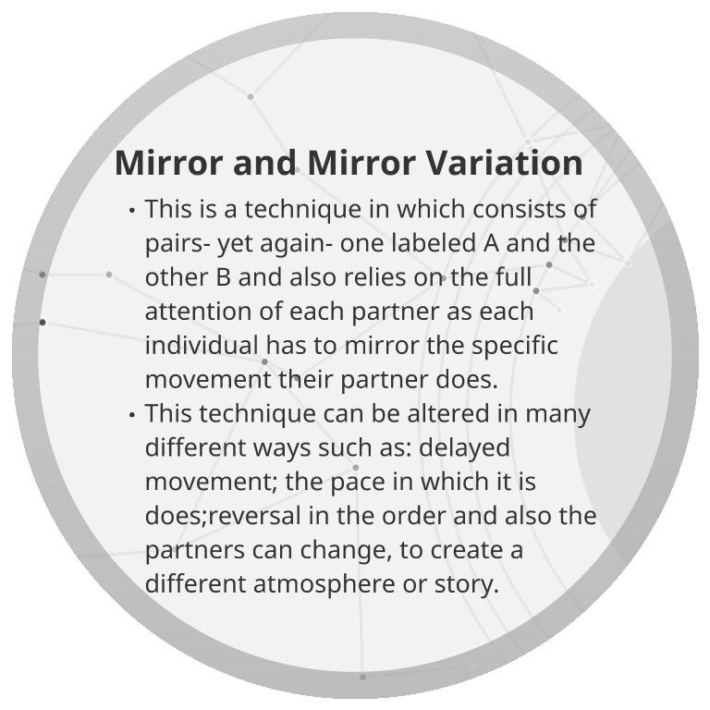
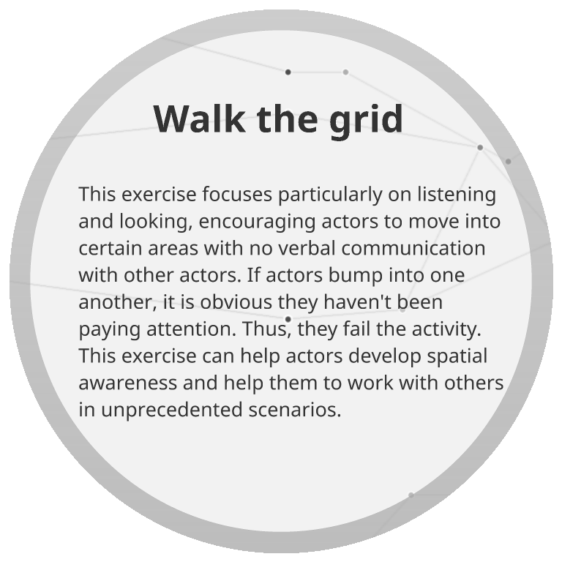
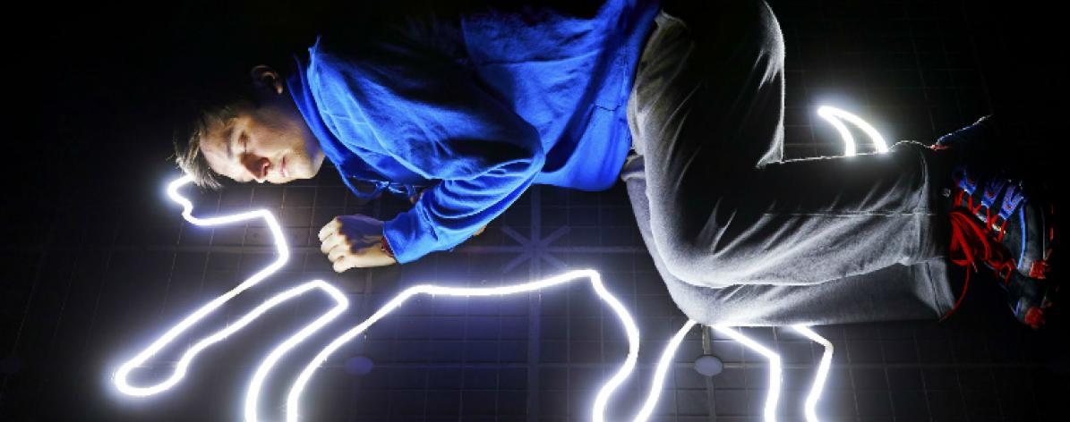
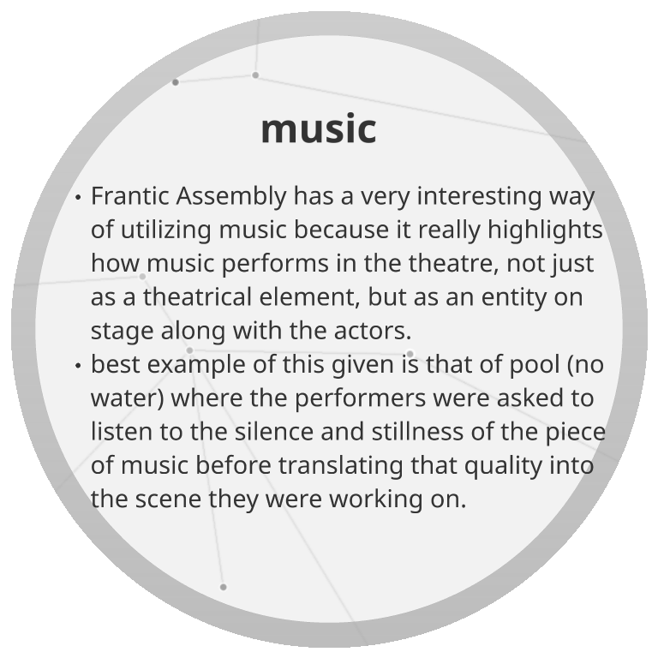
Frantic Assembly:
The Curious Incident of the Dog in the Night Time
Summer Term 1:
Devising in the style of Frantic Assembly:
Frantic Assembly is a theatre company that uses a techniques called contact improvisation – a way of improvising that requires the performers to use physical contact with others as the starting point for their own movements.
The Curious Incident of the Dog in the Night Time is about an autistic boy who struggles to express himself. Frantic Assembly used physical theatre to give the audience an insight into his thoughts. For example, unnatural movements and chaotic scenes featuring lots of performers highlighting the boy’s struggle to understand the world around his
Year 7 Drama:

Slide 6
A sample of Rehearsal techniques:
Hot seating: one person answers questions IN CHARACTER.
Thought tracking: stopping the action at any moment in rehearsal, then characters speak their thoughts
Creating unseen scenes: improvise a scene to see how your character responds. The scene need not be part of the final performance, but may reveal something about your characters personality or interactions with other characters.
Research: you may look at videos, sound clips or other internet research, particularly if you are playing a real person. Analyse their vocal qualities (pace, pause, pitch, tone, emphasis, volume, accent etc) and physicality (posture, gesture, movement etc).
Character physicality: walk around the space in neutral. Gradually experiment with your posture until you settle on one which may work for your character. Then your movement. Then your facial expressions. This will help you settle on a way in which your character moves, stands, looks etc. – remember if you are muti-rolling each character has to be completely different from one another.
Role on the wall: a black stick figure on paper, where you gradually add character information to create a profile (age hobbies, family, background, occupation, personality, significant life events etc) this builds up a well-rounded picture of the character
Levels: create a scene and then rehearse through it, each time you repeat the scene you exaggerate the movement and the dialogue to the next level (working on a scale of 1-10)
Component 2- devising: 40%
Plan your rehearsals
Spend 10/15minutes at the end of each rehearsal recording what you achieved
Write down any feedback you receive
When completing research make sure it informs your process
Record ALL websites you have found information from
Not all work you create has to be made for your performance – experimenting is just as important.
60/80 of the marks available for this component come from your log book – so you must ensure you are taking notes through your devising process.
For further support go to:
https://www.bbc.co.uk/bitesize/examspecs/zrnjwty

Slide 7
Rehearsal techniques:
Hot seating: one person answers questions IN CHARACTER.
Thought tracking: stopping the action at any moment in rehearsal, then characters speak their thoughts
Creating unseen scenes: improvise a scene to see how your character responds. The scene need not be part of the final performance, but may reveal something about your characters personality or interactions with other characters.
Research: you may look at videos, sound clips or other internet research, particularly if you are playing a real person. Analyse their vocal qualities (pace, pause, pitch, tone, emphasis, volume, accent etc) and physicality (posture, gesture, movement etc).
Character physicality: walk around the space in neutral. Gradually experiment with your posture until you settle on one which may work for your character. Then your movement. Then your facial expressions. This will help you settle on a way in which your character moves, stands, looks etc. – remember if you are muti-rolling each character has to be completely different from one another.
Role on the wall: a black stick figure on paper, where you gradually add character information to create a profile (age hobbies, family, background, occupation, personality, significant life events etc) this builds up a well-rounded picture of the character
Levels: create a scene and then rehearse through it, each time you repeat the scene you exaggerate the movement and the dialogue to the next level (working on a scale of 1-10)
Devising Project
Year 7 Drama:
Summer Term 2:
How to use your time effectively
Plan your rehearsals
Spend 10/15minutes at the end of each rehearsal recording what you achieved
Write down any feedback you receive
When completing research make sure it informs your process
Record ALL websites you have found information from
Not all work you create has to be made for your performance – experimenting is just as important.
60/80 of the marks available for this component come from your log book – so you must ensure you are taking notes through your devising process.

Slide 8
Stage Configurations:
Proscenium arch
Stage Positioning:
Year 7 Drama:
Traverse
Theatre in the Round
Thrust stage
Promenade Theatre

Slide 9
Roles and responsibilities in the theatre :
Theatre Maker:
Costume Designer
What they do:
Designing what the actors wear on stage. Making sure that costumes are appropriate for the style and period of the piece. Ensuring the costumes fit the audience.
Theatre Maker:
Technician
What they do:
Operating the technical equipment, such as the lighting and sound boards, during the performance.
Theatre Maker:
Set Designer
What they do:
Designing the set of the play and the set dressing (objects placed on the stage). Providing sketches and other design materials before overseeing the creation of the set.
Theatre Maker:
Theatre Manager
What they do:
Running the theatre building, including overseeing the front of house staff (ushers) and the box office staff who sell tickets.
Theatre Maker:
Performer
What they do:
Appearing in a production, for example by acting, dancing or singing. Creating a performance or assuming a role on stage in front of the audience.
Theatre Maker:
Stage Manager
What they do:
Running the backstage elements of the play and supervising the backstage crew. Organising the rehearsal schedule and keeping lists of props and other technical needs. Creating a prompt book and calling the cues for the performance.
Theatre Maker:
Understudy
What they do:
Learning a part, including lines and movements, so they are able to take over a role for someone if needed when there is a planned or unexpected absence.
Theatre Maker:
Director
What they do:
Overseeing the creative aspects of the production. Developing a ‘concept’ or central unifying idea for the production. Liaising with designers, rehearsing the actors and ensuring that all technical elements of the play are ready. Giving ‘notes’ to the actors to help improve their performances and agreeing the blocking (or movement) of the actors
Theatre Maker:
Sound Designer
What they do:
Designing the sound required for the performance, which may include music and sound effects. Considering if amplification, such as the use of microphones, is needed, and creating a sound plot.
Theatre Maker:
Playwright
What they do:
Writing the script of the play, including the dialogue and stage direction
Theatre Maker:
Lighting Designer
What they do:
Designing the lighting states and effects that will be used in a performance. Understanding the technical capabilities of the theatre and creating a lighting plot.
Theatre Maker:
Puppet Designer
What they do:
Designing the puppets for a production, taking into account the style of puppets and how they will be operated.
Year 7 Drama:

