Slide 1
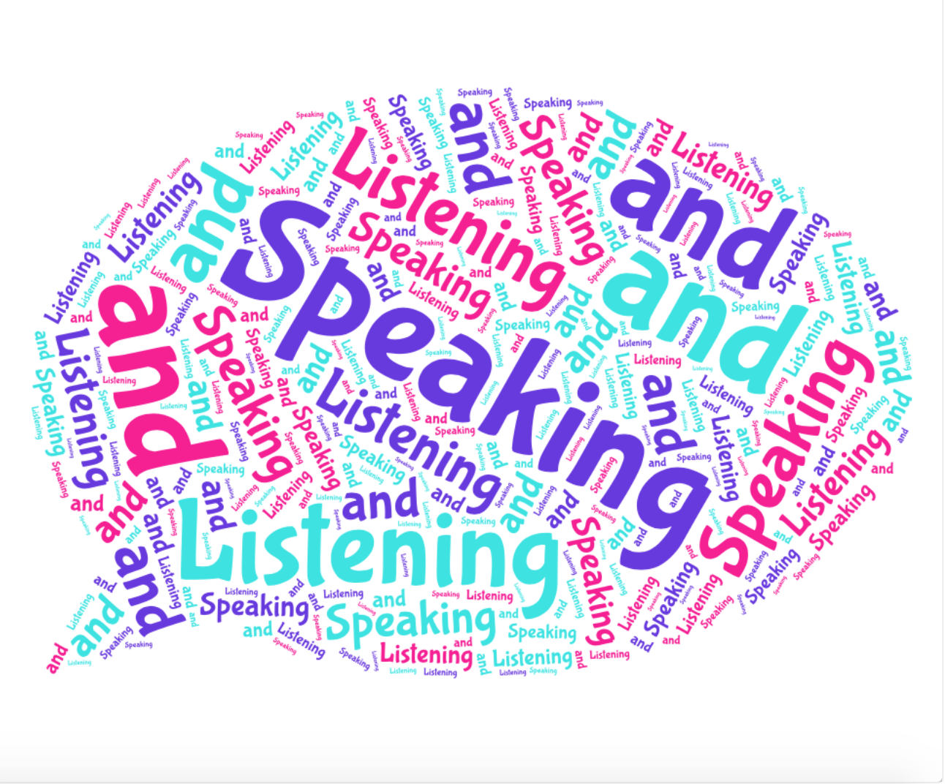
English Year 7 Speaking and Listening
2. Super Spellings
Structure
Response
Participation
Justification
Commitment
Comprehensive
Contrary
Prohibited
Predominantly
Identified
Complement
Conversely
Anticipated
Convinced
Duration
3. Comparative Connectives
Similarly…
On the other hand…
In contrast….
Moreover…
Furthermore…
In addition…
Consequently…
Subsequently…
Alternatively…
As well as this….
As a result…
Additionally…
6. Persuasive Techniques
Alliteration: starting 2 or more words with the same letter.
Anecdote: a short story to support your idea
Pronouns: I, you, he, she, we
Facts: something proven to be true
Opinion: a personal view.
Repetition: using the same word/phrase more than once.
Rhetorical Questions: a question that doesn’t require an answer but encourages deeper thought.
Exaggeration: making an over the top statement.
Emotive Language: language that is designed to evoke an emotional response.
Statistics: numerical fractions and percentages.
Threes: using three words/phrases to support or describe.
1.Key Terminology:
Structure: The order and arrangement of something.
Engage: To participate and get involved in or encourage others to do so.
Express: To clearly share an idea or opinion.
Pitch: The level of highness or lowness in a sound.
Tone of voice: The sound and pitch of your voice and how you vary this when delivering speech.
Body Language: Conscious and unconscious movements, gestures and positions of your body.
Contribution: The part played/ involvement by a person.
Compromise: An agreement or settlement that everyone is happy with.
5. The structure of a speech
Introduction: Introduce yourself and your topic in an interesting and engaging way. (e.g. start with an anecdote).
Paragraph 1: Background information
Tell your audience some more about your topic.
Paragraph 2: Key point 1
Discuss another element of your topic in detail.
Paragraph 3: Key point 2
Discuss another element of your topic in detail.
Paragraph 4: Call to action
Clarify what you want your audience to do.
Conclusion: Briefly summarise your key points and call to action. Thank your audience and leave them wanting to take action.
4. PALL
Purpose: What is the point?
Audience: Who is this aimed at?
Language: Formal or informal? Tone? Key words? Style of language?
Layout: When written, what does it look like on the page?
Notes:
Year 7

