Slide 1
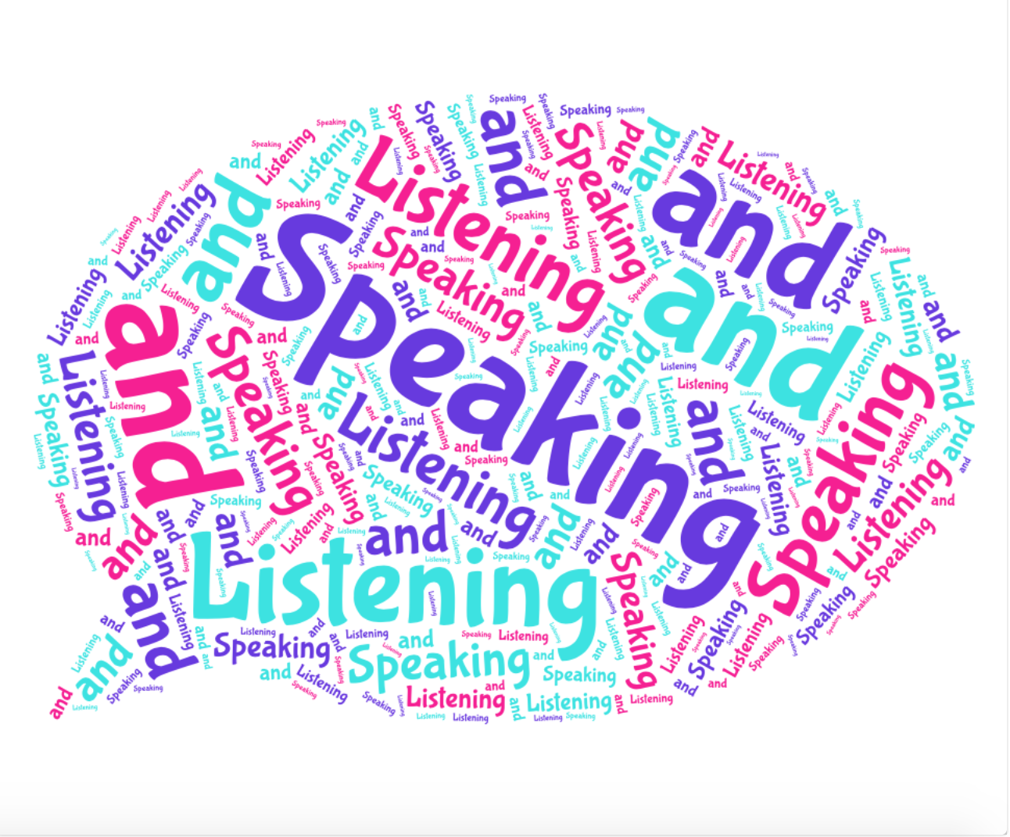
English Year 8 Speaking and Listening
2. Super Spellings
Communicate
Consider
Compromise
Impact
Identified
Source
Process
Specific
Derived
Significant
Relevant
Convention
Dominant
Alternative
Sequence
Circumstances
Emerged
Resolution
3. PALL of ‘The Games Room’ speech
Purpose: To persuade the audience to invest in your game.
Audience: A panel of industry experts looking to invest in a new game.
Language: Persuasive, informative and engaging
Layout – 6 paragraphs including:
Introduction
Setting and plot
Introducing the main character
Explanation of how the plot develops and fills a gap in the market.
Conclusion.
1.Key Terminology:
Target Audience: The specific group of people something is aimed at.
Counter Argument: An opposing view that considers the other side of an issue.
Topic Sentence: The first sentence of a paragraph that summarises what the paragraph will be about.
Facial Expression: The way you use your face to show your emotions.
Intonation: The way you vary the pitch and volume of your voice.
Demographic: The particular group/area that your product/speech is aimed at.
Non verbal communication: Gestures, sounds and body language used to show the person speaking that you are following what they’re saying (e.g. nodding).
6. Persuasive Techniques
Alliteration: starting 2 or more words with the same letter.
Anecdote: a short story to support your idea
Pronouns: I, you, he, she, we
Facts: something proven to be true
Opinion: a personal view.
Repetition: using the same word/phrase more than once.
Rhetorical Questions: a question that doesn’t require an answer but encourages deeper thought.
Exaggeration: making an over the top statement.
Emotive Language: language that is designed to evoke an emotional response.
Statistics: numerical fractions and percentages.
Threes: using three words/phrases to support or describe.
5. Success Criteria
Express challenging ideas/information/feelings using a range of vocabulary.
Respond to what you hear in a thoughtful and considerate way.
Organise and structure ideas clearly to meet the needs of the listener.
Ask questions to clarify understanding of other’s ideas.
Engage with other’s ideas.
Listen to questions and feedback, responding formally and in some detail.
Make effective contributions which help shape discussions.
4. Famous Speeches
Martin Luther King – I have a dream
Winston Churchill – We shall fight on the beaches
Rocky Balboa – The World ain’t all sunshine and rainbows
Chicken Run – Ginger’s speech
Greta Thunberg – Global warming.
Notes:
2022 VERSION UPDATED BY NLW – this is NOT the oneDraw their attention to the S&L knowledge organiser. (make sure this is uploaded to Google C) Tell them we will

