Slide 1
Year 9 Dance Safe Practice
Year 9 Dance Critical Appreciation
Safe Practice During Rehearsal
Features of production
Warming up | Pulse raiser (run/jog) Stretches Joint Mobility Alignment Exercises We warm up to increase heart rate and body temperature
Cooling Down | Gradually bringing down heart and breathing rate (run-jog-walk) Stretch To reduce lactic acid and prevent DOMS (delayed Onset pf Muscle Soreness)
Nutrition | The food necessary for health and growth.
Hydration | The process of the body absorbing water. Avoiding dehydration: Dizziness, nausea, increase HR, increase body temperature, lack of focus/concentration, feeling faint, fatigue.
Staging/set | eg projection, furniture, structures, backdrop, screens and features of these such as colour, texture, shape, decoration, materials
Properties | eg size, shape, materials, how used etc
Costume | (including footwear, masks, make-up and accessories): features such as colour, texture, material, flow, shape, line, weight, decoration and how they define character or gender, identify dancers, enhance or sculpt the body and enhance the action
Dancers | number, gender
Aural setting | eg song, instrumental, orchestral, spoken word, silence, natural sound, found sound, body percussion, style, structure and musical elements such as tone, pitch and rhythm
Dance for camera | eg placement, angle, proximity, special effects.
Performance environments and Aural Setting
Safe Practice during performance
Performance environments | Proscenium arch End stage Sit sensitive In-the-round
Aural Setting | Song Instrumental Orchestral Spoken word Silence Natural sound Found sound Body percussion
Safe practice as a performer | Bending knees: elevating, landing, lifting, going into floor work. Transferring weight onto hands when changing to floor work. Correct alignment.
Rehearsal Space | High ceilings, optimum 21˚C temperature, no obstructions, safety mirrors, spacious, well ventilated, sprung splinter free floor.
Dancewear/hair/ jewellery | Fitted clothing and cool to avoid overheating, wrist/knee/ankle supports, bare feet or correct shoes, hair tied back, no jewellery.
GCSE Dance Dance Anthology

Slide 2
Technical Skills
Physical Skills
Expressive Skills
ACTIONS: Eg: Having good elevation makes jumps higher and creates dramatic effect. Link to space: Having the ability to transfer your weight well means you can change direction quickly. Space: The ability to use a wide variety of spatial elements in performance creates more interest and impact than performing it all in a small area. This links to your mental skills - did you plan well enough to use a studio - or was it all at home | DYNAMICS : Ability to show dynamic contrast can create surprise & variety for an audience. Being able to show a variety of dynamics may support narrative, character or intent Rhythmic Content: Links to timing - important for drawing out musical rhythm & forming close relationships with the music. Important for maintaining unison and canon well
Moving in a Stylistic Way: Your genre dictates weight and dynamic specifics. Being able to perform these well makes the style identifiable. What genre have you used & what are the weight and dynamics requirements? May link to music. Timing: Important for hitting Maintains precision accents in the music. in unison and canon sections. performing Important for contact successful. | RELATIONSHIPS: Important for hitting Maintains precision accents in the music. in unison and canon sections. performing Important for contact successfully, Being able to use relationships in performance will help to support narrative and/or intent. Being able to trust a partner enough in contact work will make it more successful.
Posture | Creates a ‘presence’ & makes performance appear confident & sincere. Important for weight bearing in contact work. Helps with focus & projection
Alignment | Clarity of shape. Helps us appear confident. Helps extension & balance. Enables safe practice in landing a jump
Balance | Maintains stillness. Accents pause in music. May show character. May show narrative/ intent. Avoids falling.
Coordination | Builds complexity by helping us layer different movements at the same time. Assists with contact work so we can catch & lift safely. Safely move in & out of floor
Control | Smooth transition into/out of floor. Helps to support dynamic changes .Supports slow dynamic .May support character/ intent. Supports balance
Flexibility | helps with extension May create dramatic impact Enables a greater range of movement Helps to show clear shape Can make movements much bigger
Mobility | Helps with quick changes of direction. Enables dynamic variety. Helps smooth transitions between movements. Makes moving in and out of the floor easier.
Strength | Health & safety in contact work. Accents dynamic force in music Confident performance. May show narrative/ intent. Supports balance
Stamina | Means we can keep going to the end. Helps build climax or character. May support intent. A strong performance. May keep unison intact
Extension | Helps project energy outwards. Makes shapes larger. Creates a much more confident performance. Helps to show clear shape
Isolation | Can support character and intent. Assists with dynamic change & impact. May work closely with music.
Projection | Connects with the audience. Builds a confident performance. Makes a performance look sincere & committed. Energises movement.
Focus | Makes a performance look confident & sincere. Health & safety in contact work. May show character or intent. Helps with turns.
Spatial Awareness | Helps group formations. Patterning & clear Helps floor pathways. Important contact for work.
Facial Expressions | Creates character. Supports narrative & intent. Can make a performance appear more confident.
Phrasing | Works closely with music. Allows us to feel the dynamic quality of the movement. Helps show where sections start & end. May support unison/ canon.
Musicality | Helps create both close & distant relationships with music. Helps to express important dynamic qualities in the music. May show character/story
Sensitivity to other dancers | Important for safety in contact work. Important for unison and canon. Can support narrative if group relationships are key.
Communication of Intent | Uses all/any of the expressive skills to show narrative & meaning within a dance. Uses all/any of the physical, technical & expressive skills to show variety in mood
Mental Skills - Process
Systematic repetition | Builds movement memory. Improves physical & technical skills. Improves expressive skills. Builds confidence.
Mental rehearsal | Builds movement memory. Prepares the mind prior to performance. We can rehearse in our heads outside of the studio to keep momentum going.
Rehearsal discipline | Regular dance attendance means we don’t miss important learning. Breaking down sections in rehearsal builds movement memory. Working on complex moments improves physical skill.
Planning of rehearsal | Being organised ensures our skills build in enough time for the final performance. Planning group rehearsals ensures we build sensitivity to other dancers properly.
Response to feedback | Helps us improve. Important that an outside person/video recording helps us spot where we can improve further - we may not be aware of it ourselves.
Capacity to improve | When we use planned rehearsal, rehearsal discipline, commitment, mental rehearsal, systematic repetition, concentration & responding to feedback - we are showing that we have the capacity to improve our skills. All of them work together.
Mental Skills – During performance
Movement Memory | Links with Systematic Repetition so we don’t forget the dance & can then use expressive skills better. Health & safety in contact work. Helps with timing
Commitment | We can make it through to the end, no matter what. Makes movement larger and more expansive. Makes performer appear confident. Energy increase
Concentration | keeps us & our partners safe in contact work. Works with Commitment to get us from the start to the end. Helps with complex sections
Confidence | we can’t just ‘be confident’ - it takes rehearsal. It builds after using mental skills in rehearsal - so that we know what we are doing. Makes a strong performance. May support character.

Slide 3
Year 9 Dance Choreography
Structuring
Choreographic Process
Binary AB | A composition in 2 parts or sections
Ternary ABA | A composition in 3 parts.
Rondo ABCBDB | Music or dance form with alternating & repeating sections e.g. chorus
Episodic ABCD | A choreography with several sections, linked by a theme
Narrative | Dance that tells a story.
Beginning/middle/end | Beginning, middle and end of a dance.
Unity | A sense of ‘wholeness’ or harmony
Logical sequence | The flow of phrases or sections of a dance.
Transitions | Links between dance phrases or sections.
Researching | Investigate background information and meaning around a chosen stimulus.
Improvising | To create and explore movement without any forethought or preparation.
Generating | Create movement or phrases from initial ideas.
Selecting | Carefully choose as being the best or most suitable movement ideas.
Developing | Elaborate or expand by manipulating and developing the movement material.
Structuring | Organise the movement material into a whole, by creating sections and a climax.
Refining and Synthesising | Perfect and polish.
Choreographic Devices
Motif Development
Ways in which a movement phrase can be varied
Retrograde
Change levels
Fragmentation
Change directions
Add actions
Repetition
Take away actions
Change dynamics
Relationship Content
Motif | A movement phrase encapsulating an idea that is repeated and developed throughout the dance.
Motif Development | Ways in which a movement phrase can be varied.
Repetition | Performing the same action or phrase again.
Contrast | Movements or shapes that have nothing in common.
Highlights | Important moments of a dance.
Climax | The most significant moment of the dance.
Manipulation by number | How the number of dancers in a group is used.
Unison | Two or more dancers performing the same movement at the same time.
Canon | When the same movements overlap in time.
Lead and follow | One dancer moves, the other follows.
Mirroring | Performing the same action but opposite.
Action and reaction | When one dancer performs a movement which cause another to react.
Accumulation | Dancers performing a series of movements and join in at different times.
Complement and contrast | Where dancers movements are different but similar/ when dancers movements are different style.
Counterpoint | Where dancers perform different motifs at the same time.
Contact | Physical support or touch between dancers
Formations | Shapes or patterns created in space by dancers

Slide 4
Year 9 Dance
Component 1: Performance and choreography
Component2: Dance appreciation
Choreography 30%
Always work to a rehearsal plan.
The music you use is important.
Always make your choreographic intention clear.
Video your progress and reflect on your work.
Performing 30%
Practice daily – video yourself to gain feedback
Practice with focus and target
Remember your performance skills
Practice using accuracy.
Appreciation 60%
Listing actively to music of all genres
Whatever you listen to, try and identify the elements being exploited
Describe how the elements are being used
COMMAND WORDS
Compare
Identify similarities and/or differences
Define
Specify meaning
Describe
Set out characteristics
Discuss
Present key points (detailed writing taking into account different ideas, characteristics and/or features)
Evaluate
Judge from available evidence (make an informed judgment on the effectiveness)
Explain
Set out purposes or reasons
Outline
Set out main characteristics
State
Express in clear terms
Suggest
Present a possible case (present a possible answer)
Why
Give a reason or purpose
Performance 2 x set phrases through a solo performance Duet/trio performance Choreography Solo or group choreography. | Knowledge and understanding of choreographic processes and performing skills Critical appreciation of own work. Critical appreciation of professional works.
How its assessed Performance 30% of GCSE 40 marks Choreography 30% of GCSE 40 marks Total component 60% | How its assessed 40% of GCSE Written exam: 1 hour 30 minutes 80 marks Total component 40%
Writing Frameworks
Assessment
6 Mark questions.
Name it
Example
Explain it
12 Mark questions
Describe
Interpret
Evaluate
Link
Exceptional
Highly developed
Sound
Limited
Nothing worth of credit

Slide 5
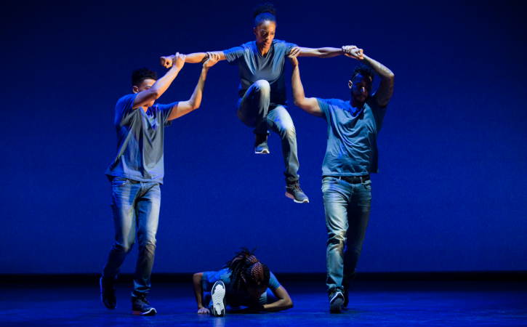
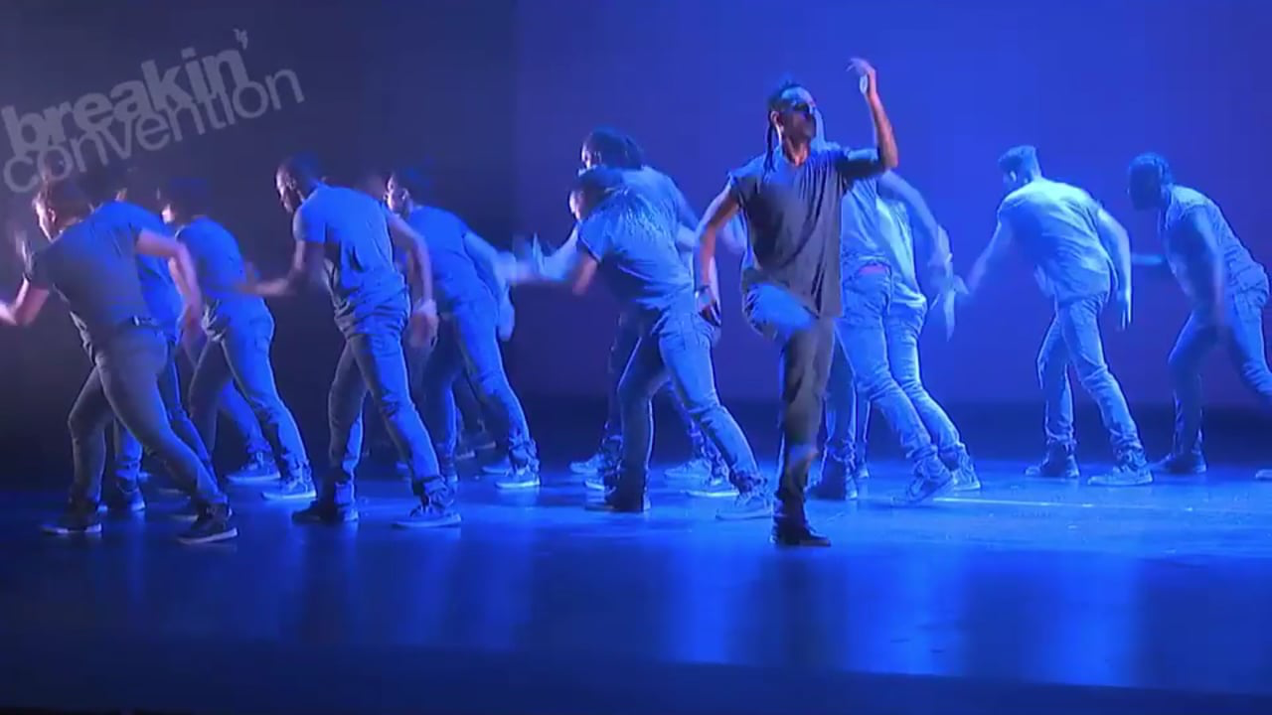
CHOREOGRAPHER: Kendrick H20 Sandy
COMPANY: Boy Blue Entertainment
AURAL SETTING
Kendrick writes out counts & uses symbols in his notes to ensure movements complement the particular instrumentation & accents.
Style:
Hip Hop including: krumping, waacking, popping, locking, breaking.
CHOREOGRAPHIC INTENTION
Journey through life (each section a scene, a moment in life)
Order and Chaos (highlighting restrictions of an individual style of hip hop dance).
STIMULUS
The music Til Enda was a starting point for the piece. Section 4 created first. The title was another starting point.
4 SECTIONS (STRUCTURE)
Genesis (start of life)
Growth and struggle
The connection and flow between people
Empowerment
LIGHTING
Intense blue colour – represent energy
Central focus at beginning and gradually light whole stage by end.
Spotlights used.
Lighting helps identify different sections.
CHOREOGRAPHIC APPROACH
Exploring & abstracting hip hop movement & ‘signature’ company movements in a contemporary way. Signature motifs (Ninja Walk, Ninja Glide, Ninja Static & Chariots of Fire)
DURATION: 11 minutes
COSTUME
Represents company (casual, blue, ‘clean’ look).
Hair tied back to see facial expressions.
Fitted to show isolations
Not restrictive to movement
Jewellery worn by some to help express individuality.
Cant be seen when not in spotlight
White light in section 2 off-stage right – significant moment

Slide 6
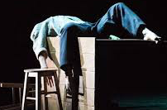
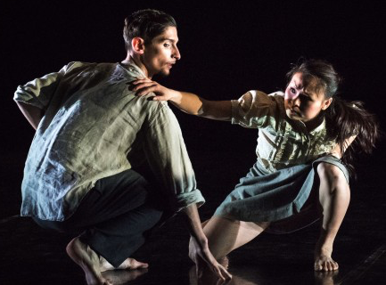
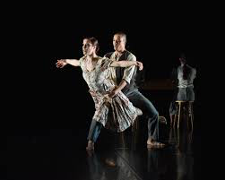
CHOREOGRAPHER: Christopher Bruce
COMPANY: Phoenix Dance Theatre
AURAL SETTING
Arvo Part’s Fratres – the version for violin & piano pre-recorded for performance. Music has no break in tempo. Music in minor key to help with dark feel of piece.
STYLE:
Neo-classical
CHOREOGRAPHIC INTENTION
Family in a dining room/kitchen
Poverty
Holocaust/political events
Fear of outside
STIMULUS
The music was the initial starting point. The music ‘evokes images of a European history and tradition steeped in over a 1000 years of suffering & human experience’.
STRUCTURE: Semi-narrative Solo, duet, trio, quartet
LIGHTING
Lighting design to create intimate space on stage depicting feeling of a ‘room’. Shadows created on stage.
Could be dim to represent candle light, showing poverty, or hiding from outside.
CHOREOGRAPHIC APPROACH
Bruce waits to work with dancers so he can be influenced by them. Started dance with idea of family unit sitting at dinner table. The ‘anxiety of the music’ greatly influenced the movement content, with the form of the piece allowing each member of family to tell their story.
STAGING/SET
Props: Table, 2 stools, bench, coat stand, 3 suitcases, 1 sack.
All worn – poverty
Helps show dining room
Integral in climax – used to barricade door
DURATION: 12 mins
COSTUME
Costumes clearly gendered, depicting era of the 1930s-1940s. Simple shirts, skirts, trousers, dresses and large overcoats.
Colours muted and worn down – deprivation & poverty. At end, they put shoes and coats on. Coats oversized for children - show poverty.

