Slide 1
Theatrical skills
Freeze frame: A frozen moment in time expressing a character / scenario.
Still image: frozen image that symbolises an idea or relationship
Thought tracking: a character saying their thoughts aloud
Hot seating: a character is asked questions and the actor responds in role
Narration: telling the audience what is happening
Mime: suggesting action, character, or emotion without words
Improvisation: creating a scene without a script
Proxemics: the use of space on stage to create meaning
Levels: the use of height to show status
Status: the power one character has over another
Physical Theatre: creating objects, set or meaning through the use of the body
Physical skills
Facial expression: showing emotion of the character through the face
Body Language: using your body to show the characters emotion
Physicality: using your body to show the character
Gesture: a movement of part of the body to show meaning.
Mannerisms: habitual gesture or way of speaking or behaving in role
Gait: the way a character walks
Posture:
Common feature of a play:
Genre: a category of drama, such as historical drama or musical.
Dialogue: what the characters say.
Monologue: a long speech spoken by one character.
Plot: the main events of the play presented in a particular sequence by the playwright.
Dramatic climax: the moment of greatest dramatic tension in a play.
Resolution: the end of the plot when the problems of the play are resolved.
Stage directions: descriptions of aspects of the play not conveyed by the actos’ speeches. These may include a description of what the set or characters look like, and the actions of the characters and how certain lines of dialogue are spoken. It may also not pauses, silences or beats to indicate when the characters are not speaking.
Character list: a list of the characters that appear in the play. Some lists include a short description of the characters, such as their age or occupation.
Character: a person or other being (such as a talking animal) in a play, novel or film.
Performance style: the way in which something is performed. A realistic performance has a believable or life-like performance style, or a comedy might feature multi-role or physical comedy as its performance style.
Vocal skills​
Pace: how fast or how slow the character speaks​
Power: how loud or how quiet a character speaks​
Pitch: how high our how low a character speaks​
Pause: moments where the character stops talking​
Tone: shows what the character thinking or how they are feeling
Intonation:
Accent:
Regonal Diolect:
 | IDENTIFY | Can you find where in the performance they have used a particular skill?
 | ANALYSE | Why have they used this technique / skill, what was the effect?
 | EVAULATE | Were they successful when using this techniques / skill? If so why? If not why not?
Command words:
Year 9 Drama specific vocabulary

Slide 2
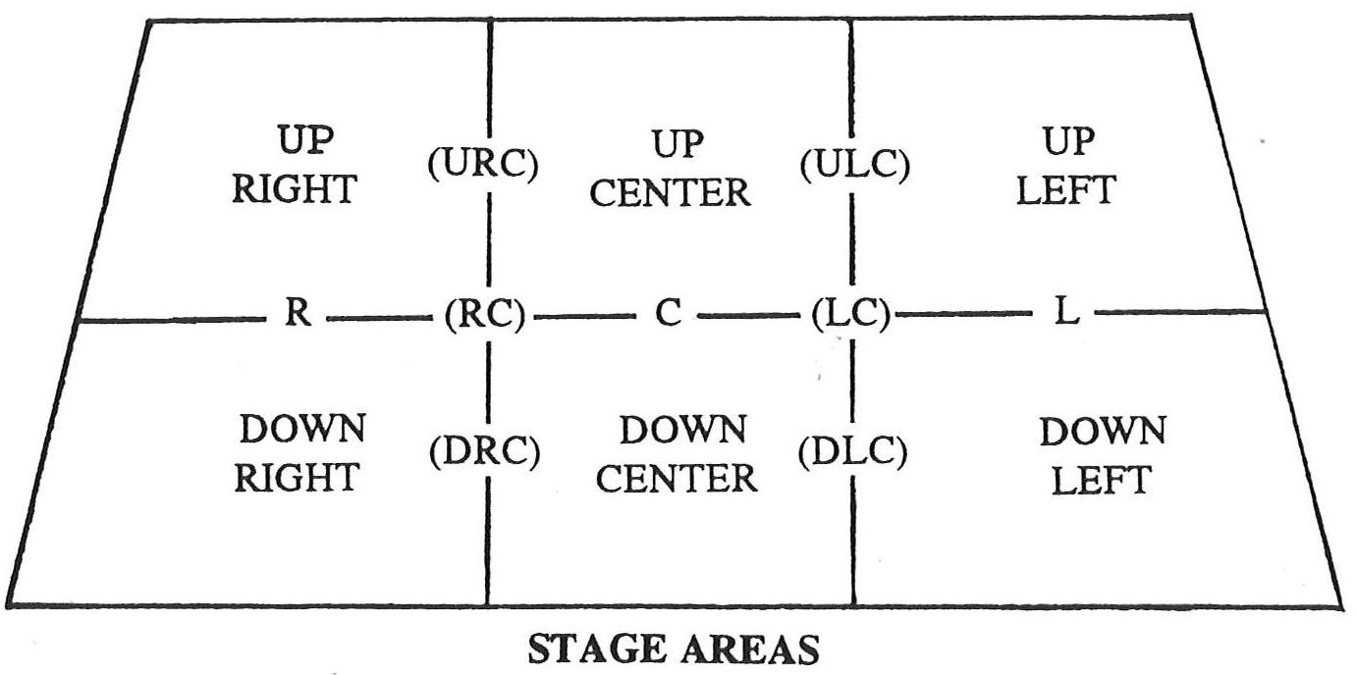
Component 1: Section A
Theatre Maker:
Costume Designer
What they do:
Designing what the actors wear on stage. Making sure that costumes are appropriate for the style and period of the piece. Ensuring the costumes fit the audience.
Theatre Maker:
Technician
What they do:
Operating the technical equipment, such as the lighting and sound boards, during the performance.
Theatre Maker:
Set Designer
What they do:
Designing the set of the play and the set dressing (objects placed on the stage). Providing sketches and other design materials before overseeing the creation of the set.
Theatre Maker:
Performer
What they do:
Appearing in a production, for example by acting, dancing or singing. Creating a performance or assuming a role on stage in front of the audience.
Theatre Maker:
Understudy
What they do:
Learning a part, including lines and movements, so they are able to take over a role for someone if needed when there is a planned or unexpected absence.
Theatre Maker:
Theatre Manager
What they do:
Running the theatre building, including overseeing the front of house staff (ushers) and the box office staff who sell tickets.
Theatre Maker:
Stage Manager
What they do:
Running the backstage elements of the play and supervising the backstage crew. Organising the rehearsal schedule and keeping lists of props and other technical needs. Creating a prompt book and calling the cues for the performance.
Theatre Maker:
Sound Designer
What they do:
Designing the sound required for the performance, which may include music and sound effects. Considering if amplification, such as the use of microphones, is needed, and creating a sound plot.
Theatre Maker:
Director
What they do:
Overseeing the creative aspects of the production. Developing a ‘concept’ or central unifying idea for the production. Liaising with designers, rehearsing the actors and ensuring that all technical elements of the play are ready. Giving ‘notes’ to the actors to help improve their performances and agreeing the blocking (or movement) of the actors
Theatre Maker:
Playwright
What they do:
Writing the script of the play, including the dialogue and stage direction
Theatre Maker:
Lighting Designer
What they do:
Designing the lighting states and effects that will be used in a performance. Understanding the technical capabilities of the theatre and creating a lighting plot.
Theatre Maker:
Puppet Designer
What they do:
Designing the puppets for a production, taking into account the style of puppets and how they will be operated.
Stage Positioning:

Slide 3
Traverse:
The acting area is a long, central space with the audience seated on either side facing each other
Advantages:
Audience feel close to the stage
They can see the reactions of the other audience members – helping with audience interaction
Extreme ends of the stage can be used to create extra acting areas.
Disadvantages:
Big pieces of scenery, backdrops or set can block sightlines
Blocking can be challenging
Actos can struggle with making themselves visible to both side of the audience
Lighting needs to be carefully designed to avoid shining lights in the audience’s eyes.
Proscenium arch:
Is a common form of theatre, popular for larger theatres. The proscenium refers to the frame around the stage.
Advantages:
Stage pictures are easily created
Backdrops / scenery can be used
There may be fly space and wing space for storing scenery
Fourth wall easily created.
Disadvantages:
Some audience members may feel distant from the stage.
The auditorium could seem very formal and rigid.
Audience interaction may be more difficult.
Thrust stage:
Protrudes into the auditorium with the audience on three sides.
Advantages:
Combine advantages of proscenium and theatre in the round
Backdrops, flats and large scenery can be used.
Audience may feel closer to the stage
Disadvantages:
Sightlines for those on the extreme sides may be limited or obstructed
The audience on the right and left have each other in their view
Box sets (where three sides of a room are constructed) cannot be used as this would block views for much of the audience
Advantages:
Directors and actors often find it very dynamic, interesting space because the audience is close to the stage
Actors enter and exit through the audience, engaging them
There is no easily achieved ‘artificial fourth wall’ separating the audience from the acting area
Disadvantages:
Cannot use backdrops or flats that would obscure the view of the audience
Stage furniture has to be chosen carefully so sightlines aren’t blocked
Actors have to be carefully blocked so that audience aren’t blocked for extended periods of time.
Theatre in the round:
is a stage configuration when the audience are seated around all sides of the stage
Advantages:
It is interactive and exciting – the audience may feel more involved.
Disadvantages:
The audience moving difficult or get tired of standing
Actors/crew need to be skilled at moving the audience around/controlling their focus
Promenade theatre:
Is when the audience stand or follow the actors through the performance.

Slide 4
Motherhood.
Judgement.
Love.
Nature v Nurture.
Class.
Superstition.
Fate/Destiny.
Power.
Themes:
Useful links to support research for component 1 and 2:
Bloodbrothersmusical.com - Getrevising.co.uk
BBC bitesize
Key characters:
Narrator – takes on multiple roles
Mrs Johnstone – Mother of the twins, impoverished.
Mrs Lyons – takes Eddie, privileged.
Mickey – poor twin, frequently downtrodden
Eddie – rich twin, not streetwise
Sammy - delinquent brother to Mickey
Linda – Mickey’s girlfriend and Eddie’s secret love
Mr Lyons – Father of Edward
KEY QUOTES:
- ‘Y’know the devil’s got your number’
- ‘And do we blame superstition for what came to pass? Or could it be what we, the English, have come to know as class?’
- ‘The welfare have already been onto me’
- ‘See this means that we’re blood brothers, an’ that we always have to stand by each other’
How to approach question:
Technical language – use the accurate terminology to describe each aspect of a production, such as performance skills, design features and stage configurations
Examples from the play – include examples (e.g. quotes, context or events) that demonstrate understanding of the play and support the point your making.
Detailed suggestions- give specific details on how you would perform, design and direct a production that will help the examiner to visualise your ideas.
Effect on the audience – describe the desired effect of a production on the audience., as well as how this effect might be created using theatrical techniques.
Contextual information:
- Willy Russell wrote Blood Brothers in 1981.
- It was first performed in Liverpool before transferring to the West End.
- It was first performed as a musical in 1983.
- Conservative Prime Minister Margaret Thatcher was in power at this time.
- There was a very high rate of unemployment at this time.
- The play is set in Liverpool, as areas of high unemployment within the industrial working class.
Blood Brothers,
Component 1, Section B
Genre: Book Musical.
Links to Epic Theatre
Stylistic features and symbols:
Reprise – a song or part of a song that is repeated. Often it is intermingled with a new song. E.g. Marilyn Monroe.
Motif – A dominant or recurring image or idea in a text e.g. the gun.
Juxtaposition – Two opposite ideas are near each other in a piece of writing.
Foreshadowing – when the author alludes to what is to come in the text.
Parallel – two corresponding things that run side by side, e.g. the school scenes.
Cyclical – the structure of the play is cyclical as it starts and ends in the same place.
Soliloquy – when a character speaks their thoughts aloud, to themselves. It is different to a monologue which is one-character speaking, but in front of others
Antihero – a central character in a story, film, or drama who lacks conventional heroic attributes.
Narrator – echoes the function of the Greek Chorus, asks the audience to detach and judge.
Stage Directions – used prolifically by Russell to describe the movement and actions of characters.

Slide 5
A sample of Rehearsal techniques:
Hot seating: one person answers questions IN CHARACTER.
Thought tracking: stopping the action at any moment in rehearsal, then characters speak their thoughts
Creating unseen scenes: improvise a scene to see how your character responds. The scene need not be part of the final performance, but may reveal something about your characters personality or interactions with other characters.
Research: you may look at videos, sound clips or other internet research, particularly if you are playing a real person. Analyse their vocal qualities (pace, pause, pitch, tone, emphasis, volume, accent etc) and physicality (posture, gesture, movement etc).
Character physicality: walk around the space in neutral. Gradually experiment with your posture until you settle on one which may work for your character. Then your movement. Then your facial expressions. This will help you settle on a way in which your character moves, stands, looks etc. – remember if you are muti-rolling each character has to be completely different from one another.
Role on the wall: a black stick figure on paper, where you gradually add character information to create a profile (age hobbies, family, background, occupation, personality, significant life events etc) this builds up a well-rounded picture of the character
Levels: create a scene and then rehearse through it, each time you repeat the scene you exaggerate the movement and the dialogue to the next level (working on a scale of 1-10)
Component 2- devising: 40%
Plan your rehearsals
Spend 10/15minutes at the end of each rehearsal recording what you achieved
Write down any feedback you receive
When completing research make sure it informs your process
Record ALL websites you have found information from
Not all work you create has to be made for your performance – experimenting is just as important.
60/80 of the marks available for this component come from your log book – so you must ensure you are taking notes through your devising process.
For further support go to:
https://www.bbc.co.uk/bitesize/examspecs/zrnjwty

Slide 6
Practitioner Techniques:
Component 2: Devising in the style of…
‘Total theatre is a use of the imagination. Actors express the genius of the body. Express the story without a set’.
The audience ‘hang up their brains with their hats’… we need to ‘change the world it needs it’
BERKOFF:
BRECHT:
Exaggerated & stylised mime
Exaggerated facial expressions
Externalising emotions
Physicalisation of objects
Rhythm through voice and body
Abstract use of voice and ensemble playing.
Stylised movement/speech patterns (slow motion/robotic)
Exaggerated vocal work
Direct address
Gesture/Pose
Tableaux
Body Props
Formal leading characters taking the audience through the narrative – monologue (with ensemble movement in the background
Breaking the fourth wall
Montage
Use of song, music and dance
Narration
Speaking in the third person
Minimal set, props and lighting
Coming out of character
Using placards
Freeze frames / tableaux
Title cards
Multi-rolling
Presents an argument
Alienating the audience
Social political issues
Telling the story out of order

