Slide 1
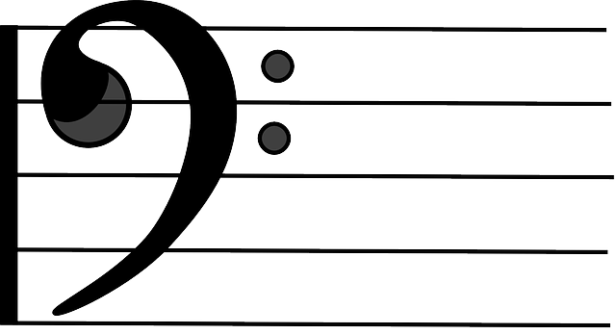
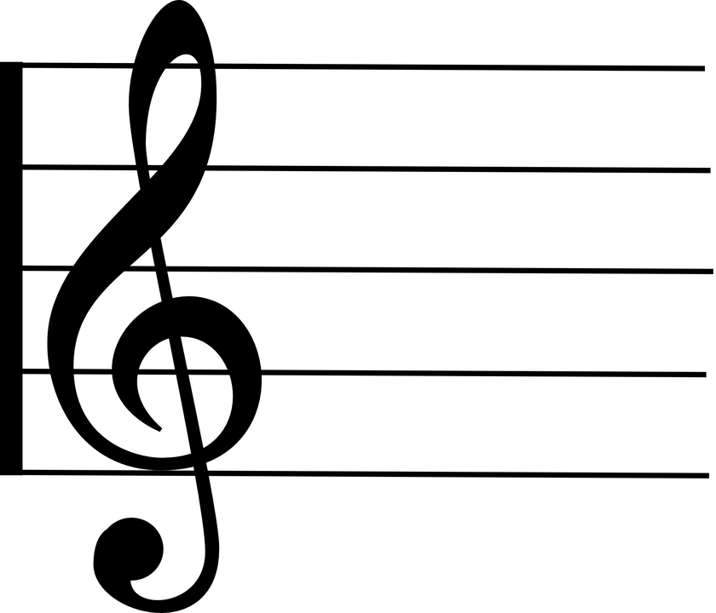

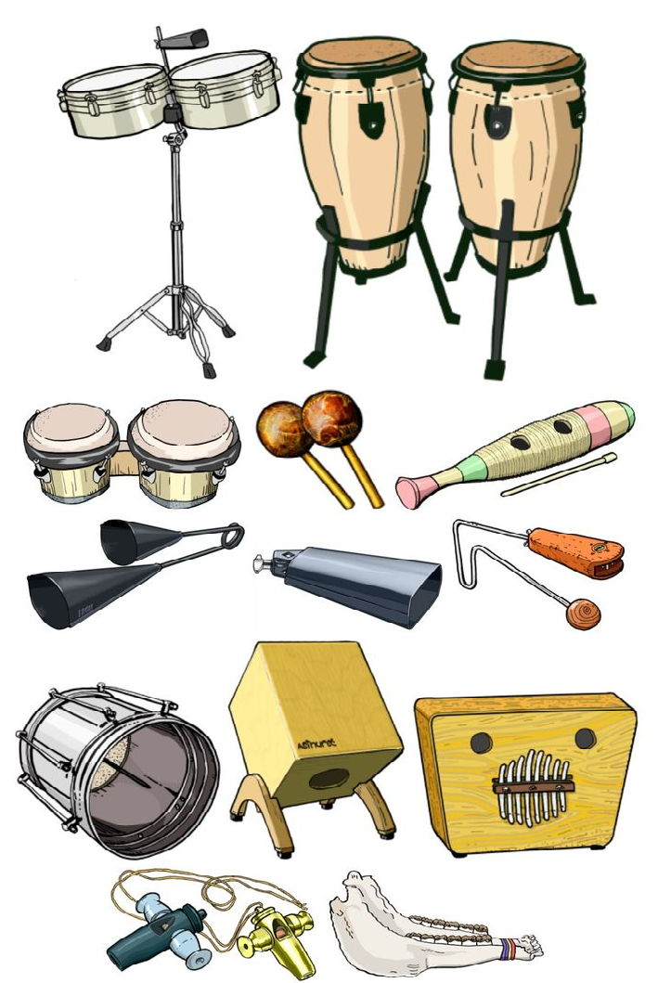
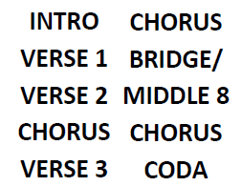



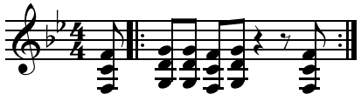
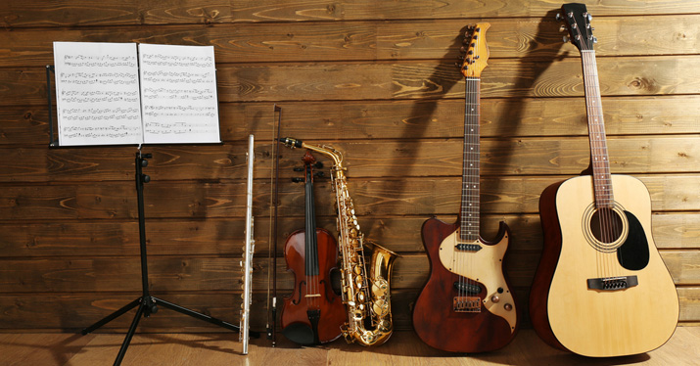






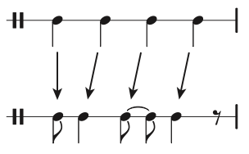
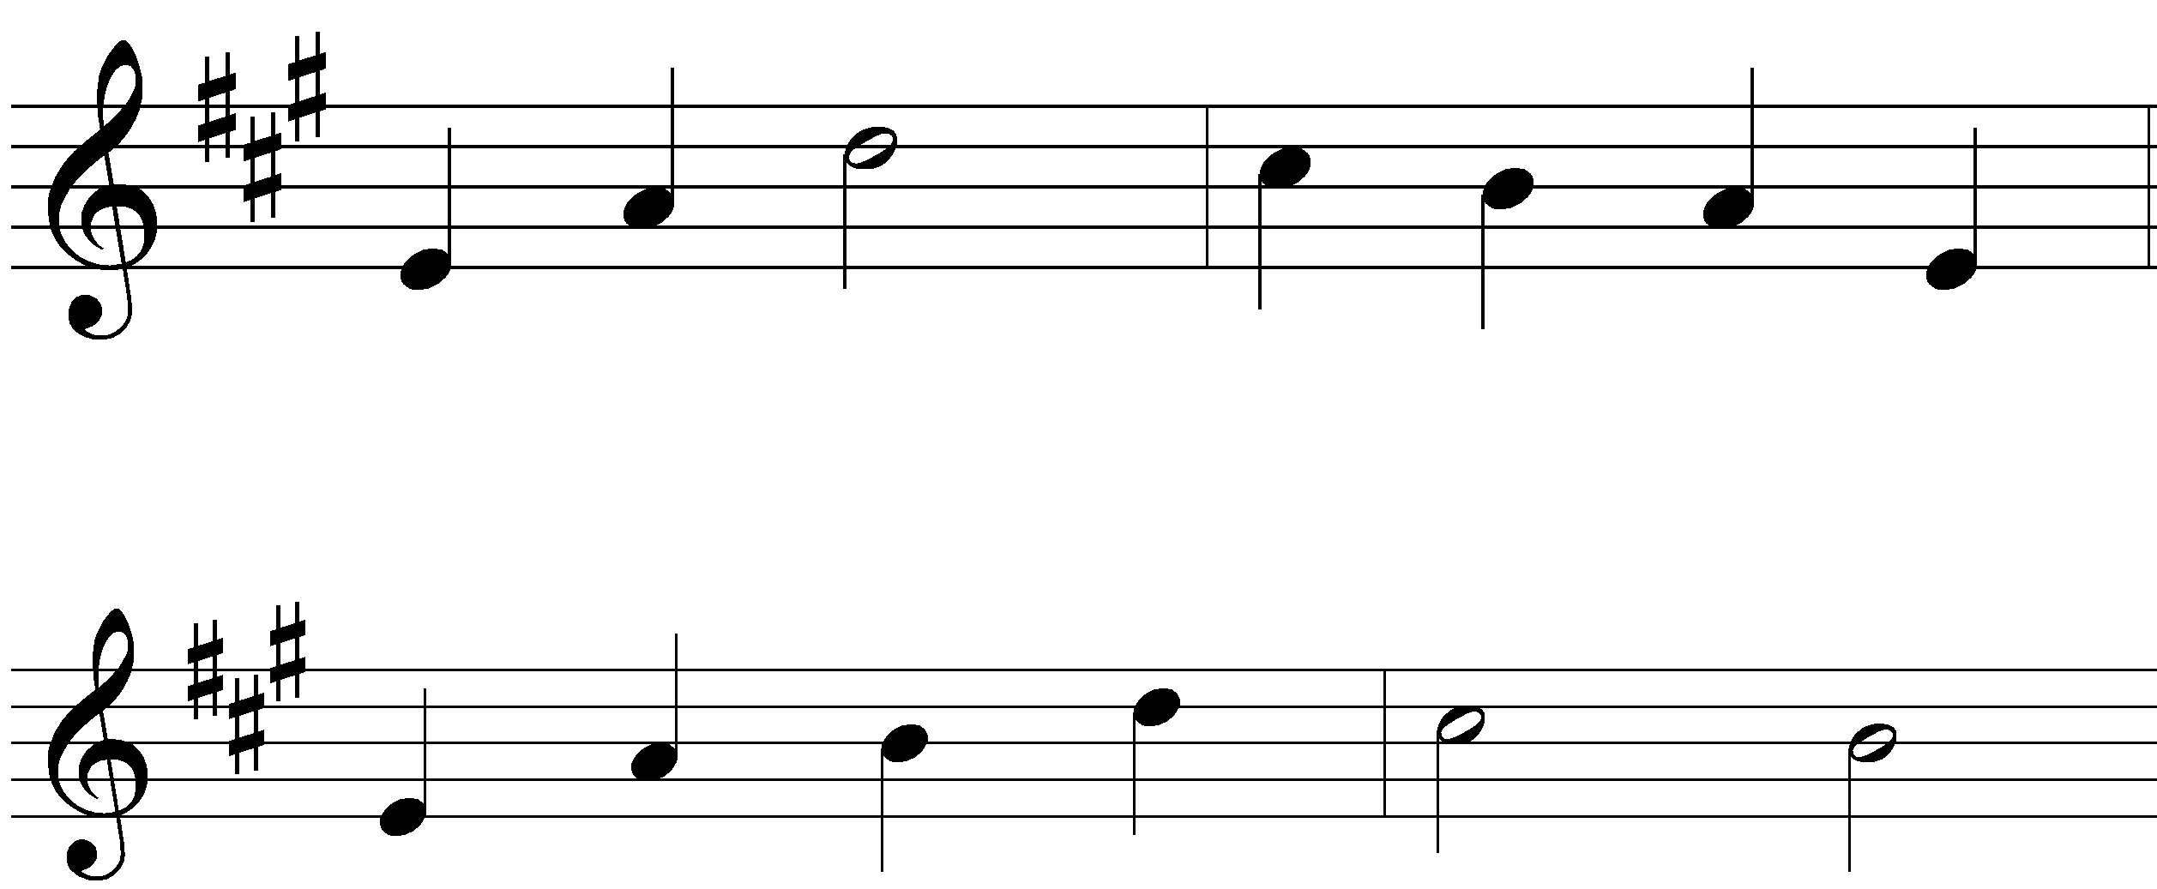
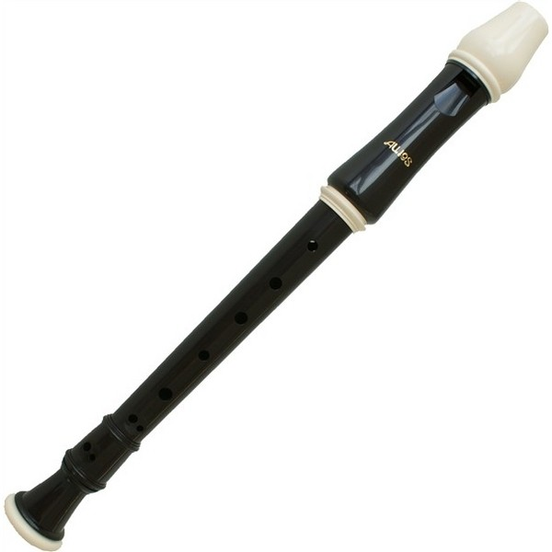


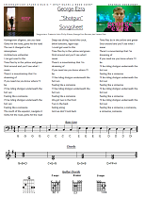
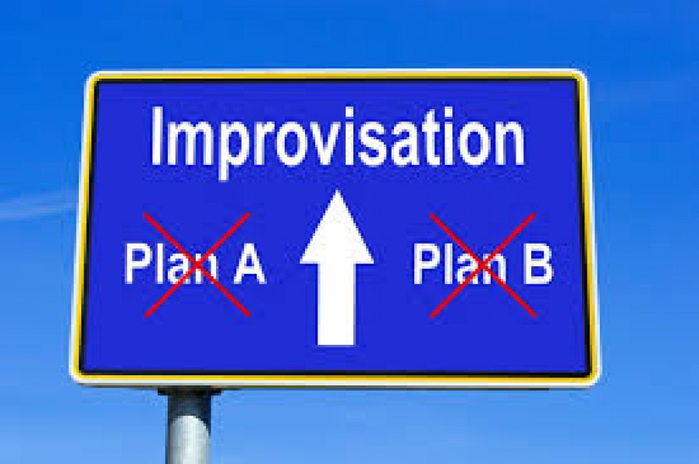




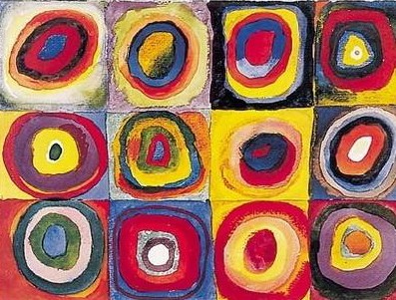











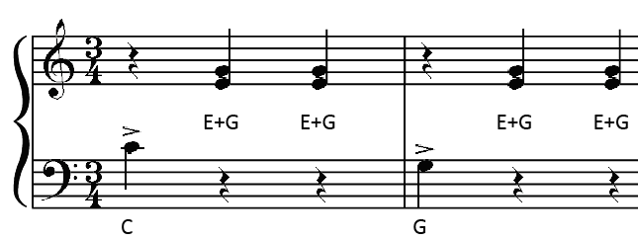
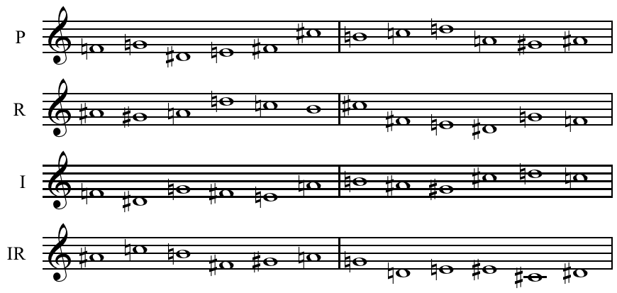

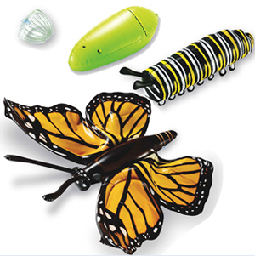

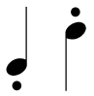
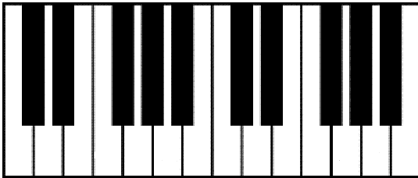




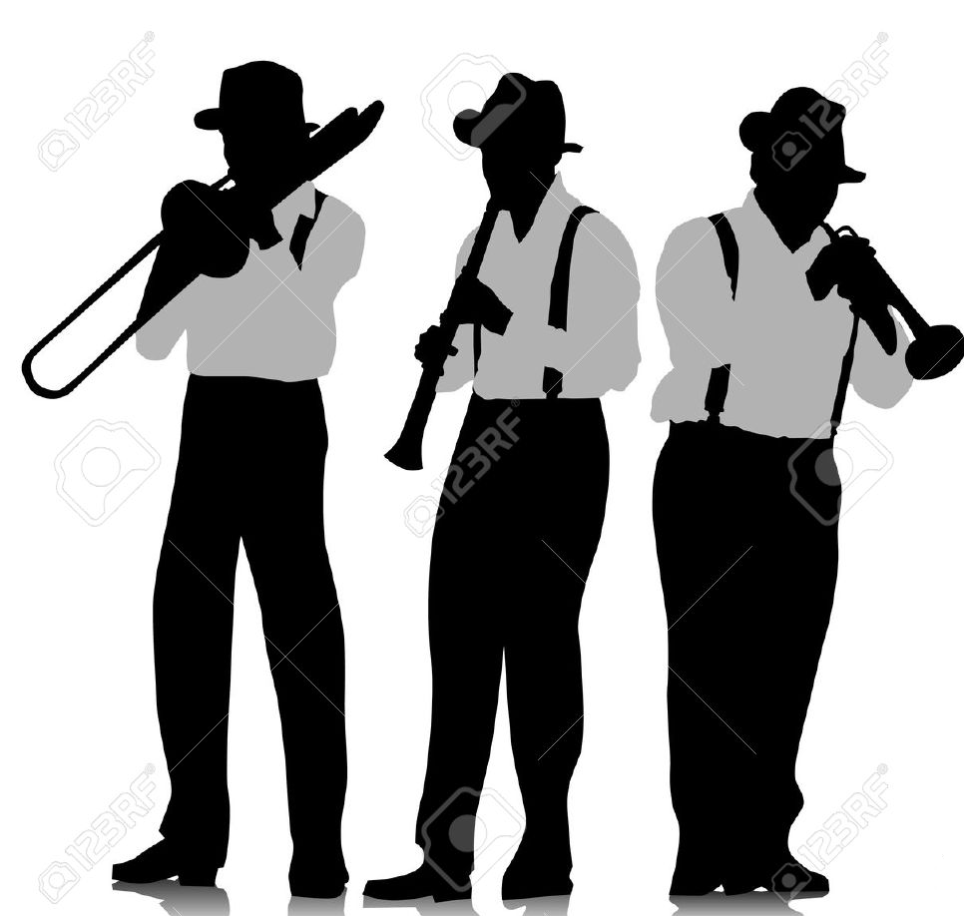
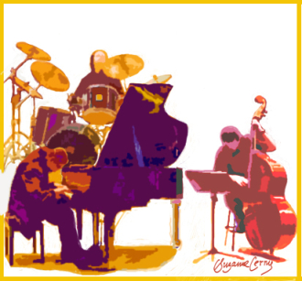
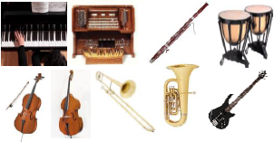
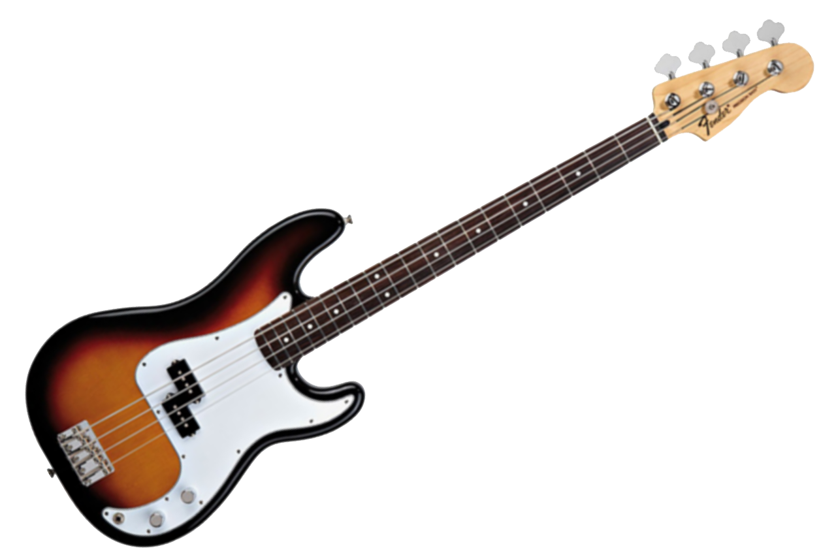
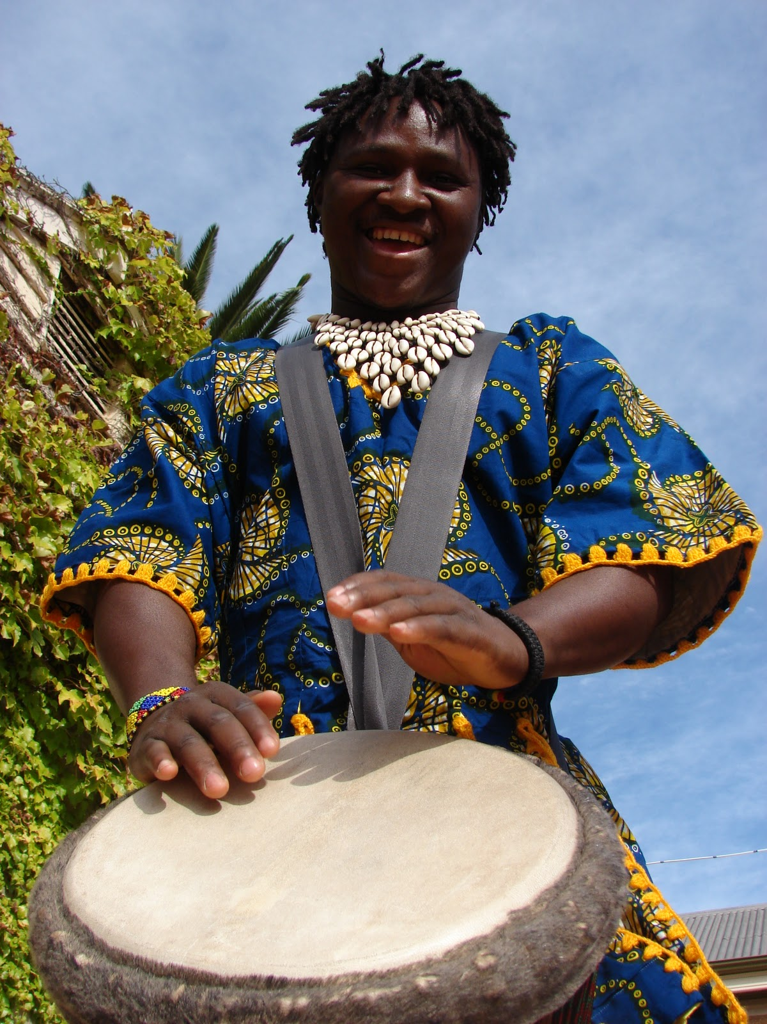



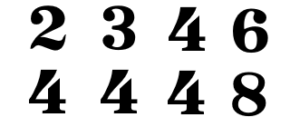
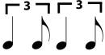


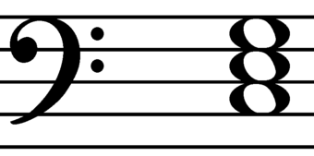
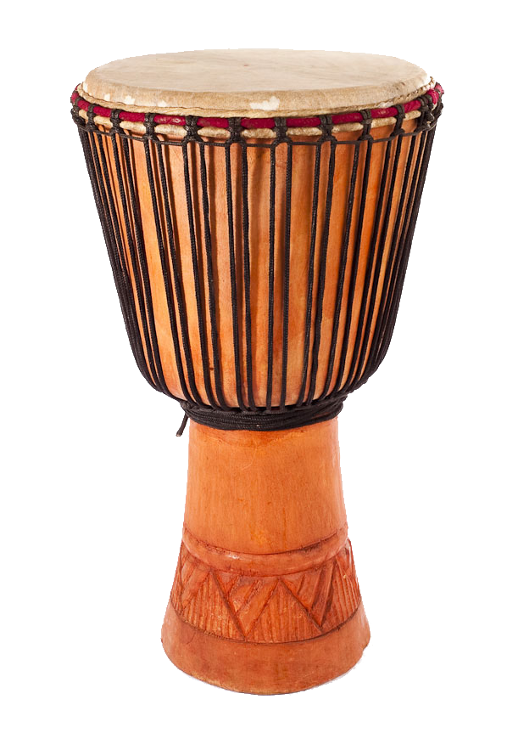
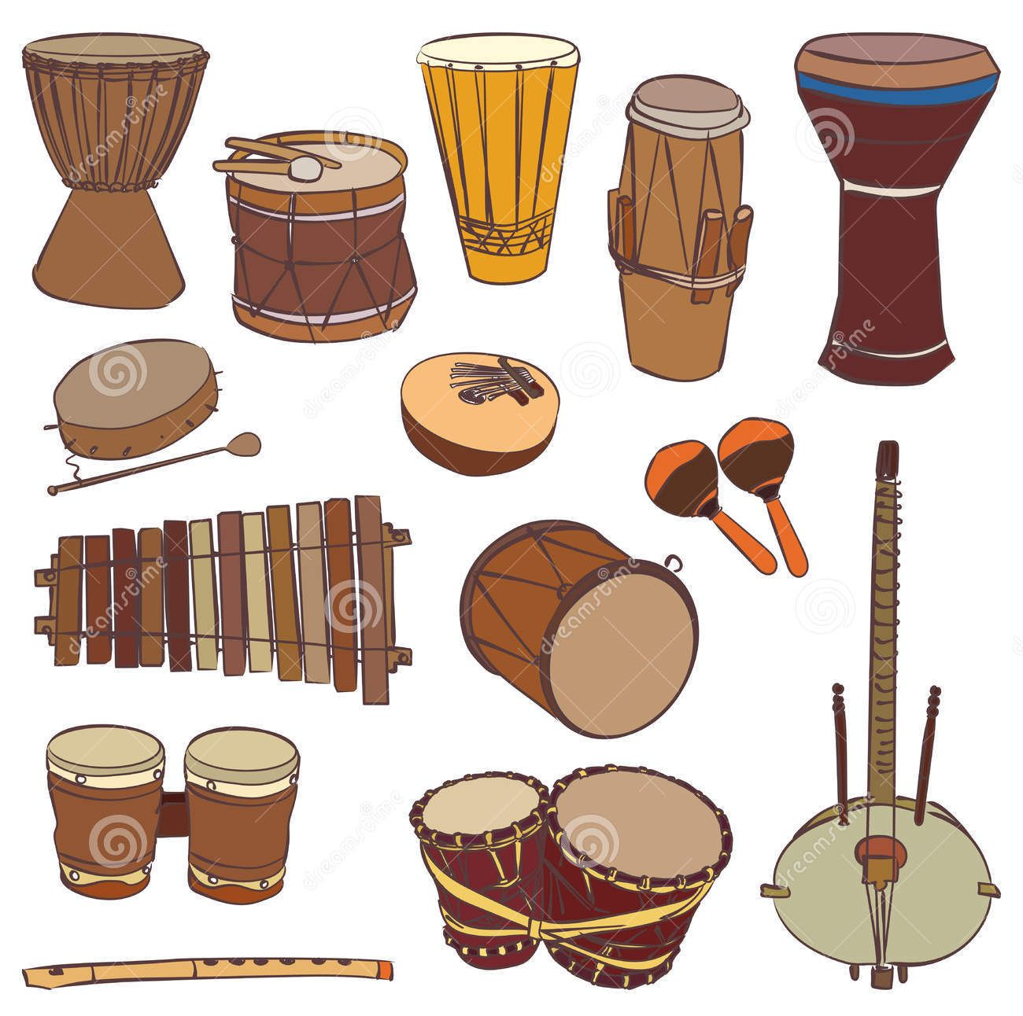


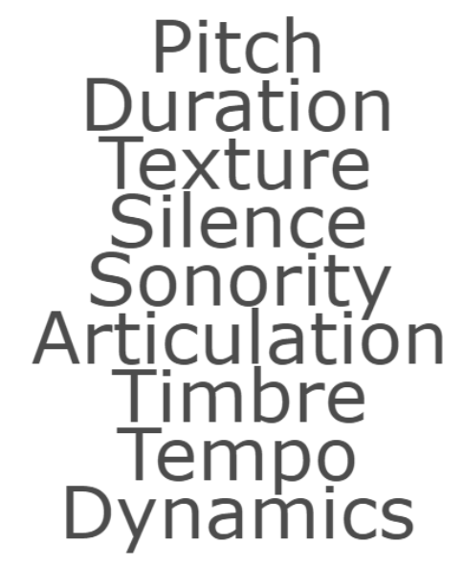

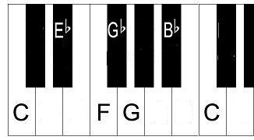





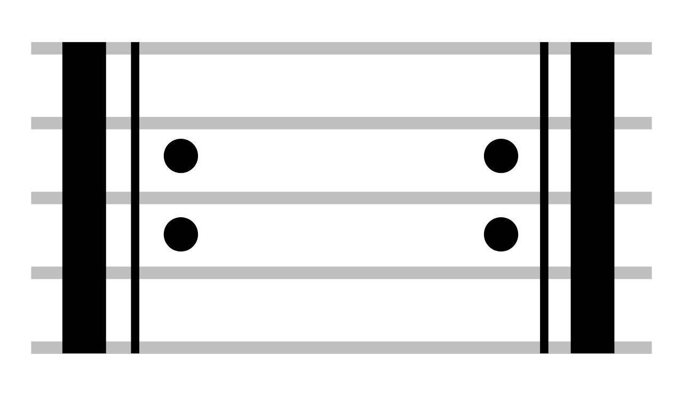
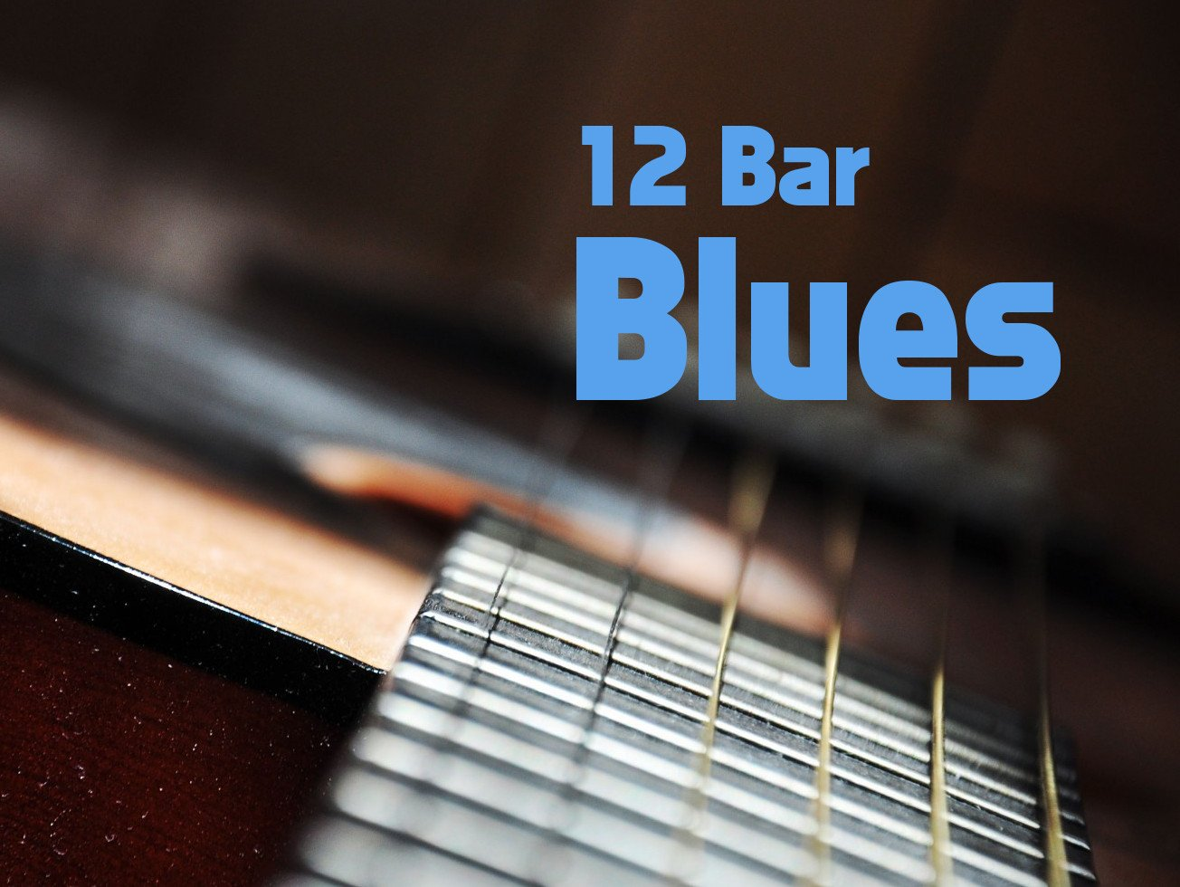


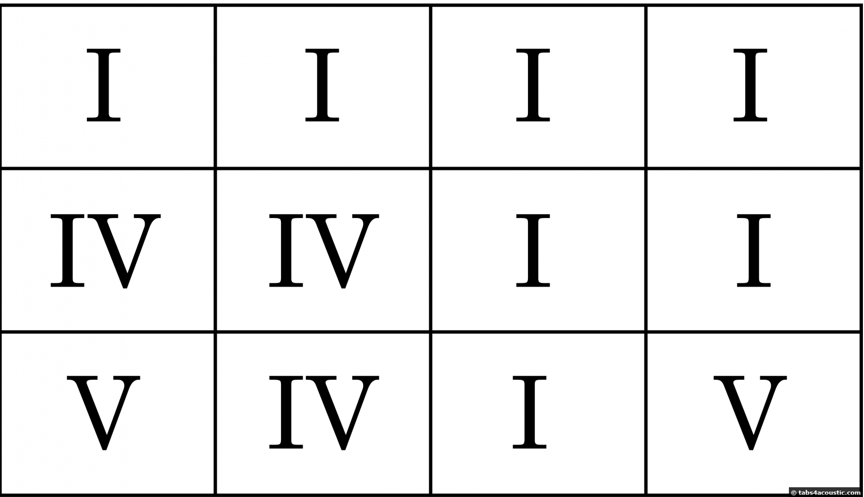

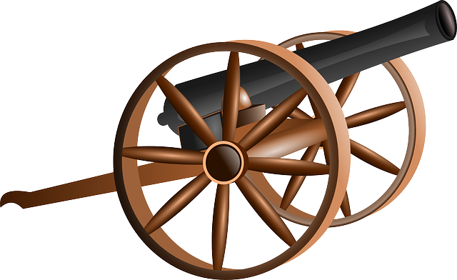
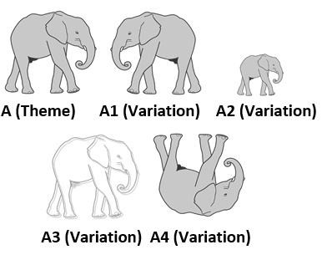
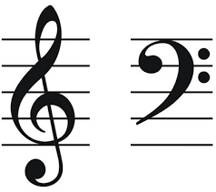
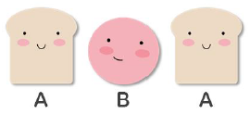

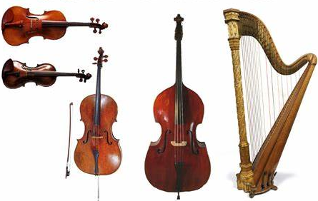
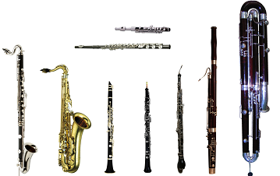
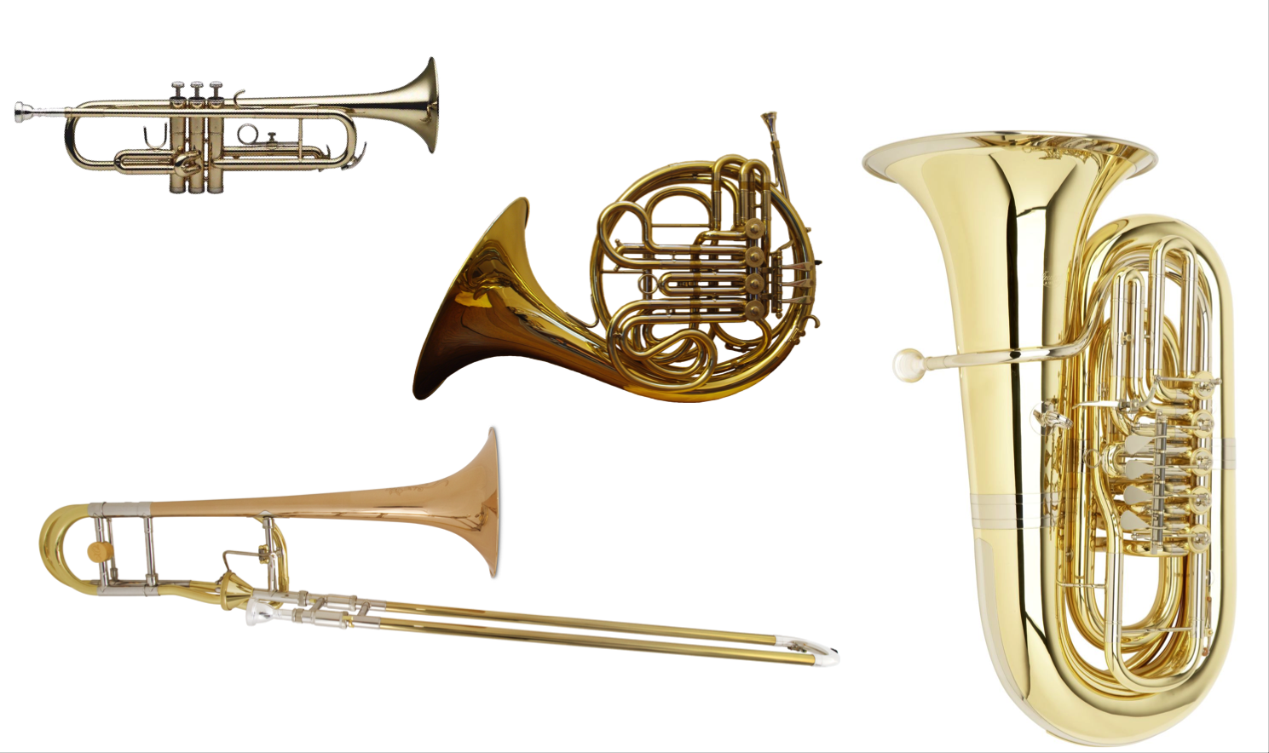
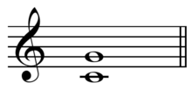




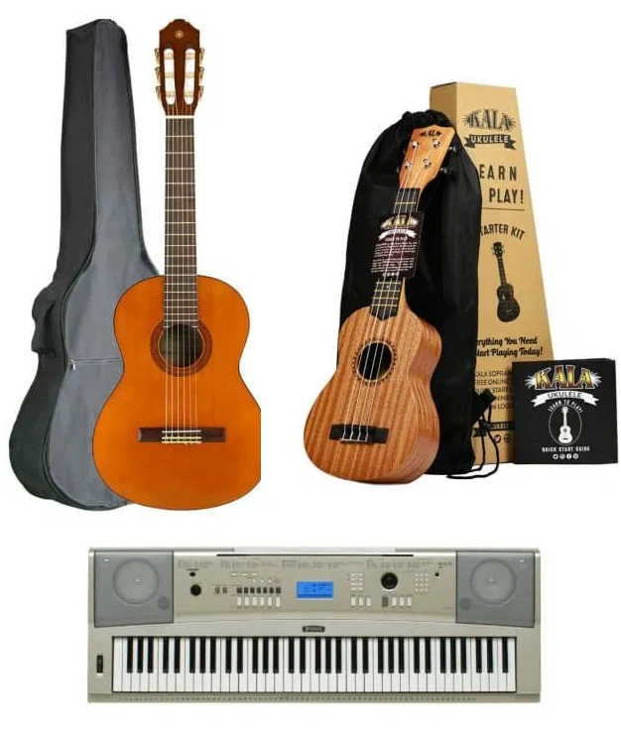
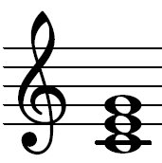


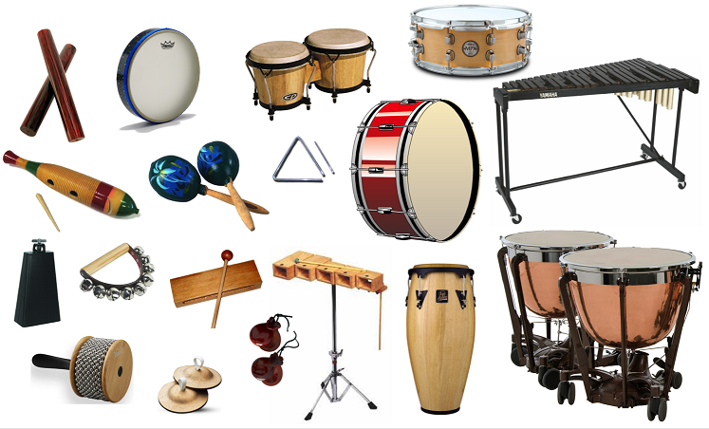
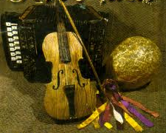

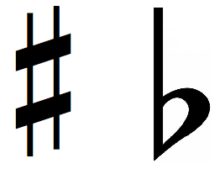





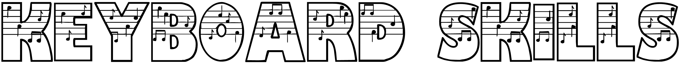
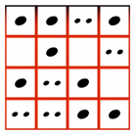
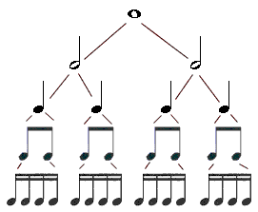

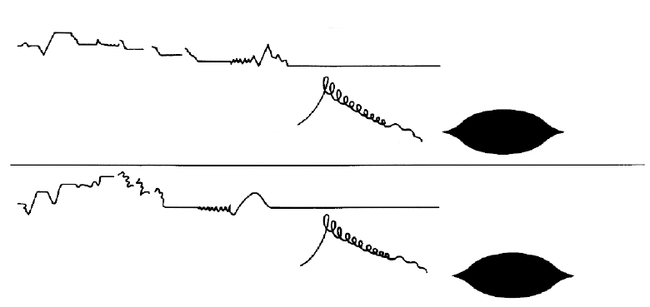
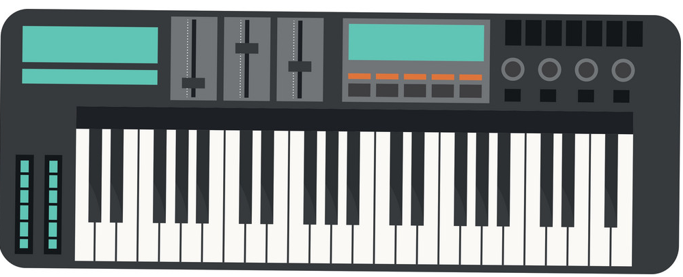
Tiverton High School Music Department
Creating Musicians
The Music Curriculum for Years 7 to 9
Learning Journey
Performing as an Ensemble
Pulse, Beat & Rhythm
Latin-American
Percussion
Lyrics and Song Words
Hooks and
Riffs
Popular Song Structure
Instruments, Timbres and Sonorities in Songs
Creating a Musical Arrangement
Cover Version
YEARS
10
11
Cyclic Rhythms
Polyrhythms
Ostinato
Syncopation
Melody and Counter-Melody
Melodic Motion: Conjunct, Disjunct, Range
Texture – Melody, Counter-Melody, Hooks/Riffs, Chords, Accompaniment, Bass Line
Notation – Lead Sheets
Improvisation
Q&A/Call and Response
Inversion
Retrograde
Minimalism, Expressionism, Serialism
Dance Music from different times and places
Accompaniment Patterns in Dance Music
Motif/Cell
Hexachords
Jumping Bass
Line
Character Theme
Motif
Soundtrack
Sound Effect
Dissonance
Mickey-Mousing
Diegetic
Non-Diegetic
Augmentation
Diminution
Additive
Melody
Texture – Melody and Accompaniment
Note/Tone Rows
Metamorphosis
Phase Shift
Phase In/Out
Staccato
Articulation
Chromaticism
Ground
Theme
Syncopation
Musical Clichés
Leitmotif/
Sequencing
Orchestration
Timbre
Sonority
Rhythms in Dance Music
Primary Chords
Rhythm
Section
Textures and Layers
Q&A/Call and Response
I IV
V V7
Frontline Instruments
(Solos)
Bass Clef Staff Notation
Bass Clef Musical Instruments
The Bass Guitar
Master
Drummer
Ostinato
Syncopation
YEAR
9
Simple and Compound Time Signatures
Ostinato, Riffs
Fills & Solos
Swing/Swung Rhythms
Ragtime
Modal Jazz & Modes
Bass Line Patterns: Walking Bass, Bass Line Riffs, Alberti Bass, Broken Chord, Arpeggio, Pedal
Chords – Root, Third and Fifth
Djembe Performance Technique – Bass, Tone & Slap
Improvisation
Textures -
Cyclic and Polyrhythms
African Musical Instruments
Improvisation
Blues Scale
Types and Styles of Jazz
Blues Songs Lyrics
I II IV V
Reggae Song Lyrics
Texture – Melody, Chords and Bass line
Chord Vamps
Augmentation
Diminution
Pedal
Counter Melody
Melody/Theme
The Elements of Music
Chords I, II,
IV & V
Texture and Layers
Repetition
Chords I, IV & V
and I7, IV7 & V7
Blues Song Structure
Hooks – Melodic, Rhythmic & Verbal
I IV V
I7 VI7 V7
Blues Chord Sequence
12-Bar Blues
Inversion
Retrograde
Major & Minor
Canon
Round
Ground Bass
Variation
Form
Creating a
Reggae
Arrangement
Hooks and Bass Line Riffs
Syncopation
Off Beats
Treble & Bass Clefs
Ostinato
Riffs
YEAR
Ternary Form (ABA)
Rondo Form (ABACADA..)
String Instruments
Woodwind Instruments
Brass Instruments
Harmony:
Intervals
Folk Song Accompaniments: Pedal, Drone, Ostinato, Alberti Bass, Broken Chord, Arpeggio,
8
Binary Form
(AB)
Chords as an Accompaniment: Keyboard, Guitar, Ukulele
Q&A/Call and Response Phrases
Texture - Melody, Drone and Ostinato
Treble Clef Pitch Notation
Timbre and Sonority
Performing as an Orchestral
Ensemble
Percussion Instruments
Instruments of Folk Music
Creating a Folk Song Arrangement
Notation – Lead Sheets
Simple Time
Signatures
Ostinato
Cyclic and Polyrhythms
Sharps and Flats
Treble Clef Staff Notation
Baseline Assessments
(Listening, Performing & Composing)
YEAR
Rhythm Grid Notation
7
Note Durations
Pulse/Beat
Christmas Performance
Melody and Chords (Triads)
Effective Keyboard Performance Technique
Graphic Notation & Graphic Scores
The Elements of Music

